Slide 1
Managing with Measures for Performance Improvement
Office of Quality Management
Office of Research Services
National Institutes of Health
October 2005

Slide 2
Session Outline
Background
Overview
Developing Measures Effectively
Managing With Measures
  Service Group Examples
Questions
Session Evaluation

Slide 3

Background
The President's Management Agenda, announced in the summer of 2001, is an aggressive strategy for improving the management of the Federal government. It focuses on five areas of management weakness across the government where improvements and the most progress can be made.
Factual Example -
The Federal government spends over $25 billion annually on IT systems and services. Do these services improve efficiency or reduce costs? It is likely they do, but without measuring and communicating the results, how will anyone know?
More information at www.whitehouse.gov/omb/budintegration/pma_index.html

Slide 4
Overview
OVERVIEW

Slide 5
Summary Overview
Organizations succeed when resources within a service group work together to achieve a common goal.
This is also true for performance measurement which includes establishing operating strategies, defining processes that contribute to the strategies, and evaluating, using and communicating the results to improve performance.

Slide 6
Overview (Performance Measurement)
Iterations of Performance Measurement
Organization value proposition &
objectives
Determine
New objective added
Customer needs
& requirements
Measured results
Refine as
needed
Results not used
New mandated requirement
Collect &
evaluate
Target met- new
stretch target set
Requirement successfully met-
shift focus
Select
Performance
measures
Prioritized
requirements
Develop/refine

Slide 7
Overview (continued)
Some of the leading methods that are helpful in
implementing and managing for performance
improvement include:
The Balanced Scorecard (Performance Management Plan)
Productivity
Continuous Improvement
Process Improvement
These methods compliment each other and should be
incorporated for performance improvement.

Slide 8
Overview (Balanced Scorecard)
Balanced Scorecard (Performance Management Plan):
A new management concept (1992) helps managers at
all levels monitor results in their key areas:
financial performance,
customer knowledge,
internal business processes,
learning and growth.
This allows the monitoring of present performance, but
also tries to capture information about how well the
organization is positioned to perform well in the future.

Slide 9
Overview (Productivity)
Productivity:
Productive business tend to succeed over less
productive competitors because their costs are lower for
the same level of output. How can management
act to increase productivity?
  Ensure that the overall direction of the organization is correct and clear.
  Ensure that communication is clear, thorough and open. If everyone is aligned, less time and energy is wasted.
  Detect problems early, and nip them in the bud.
  Ensure the group is not reacting to imaginary problems. Use process behavior charts to track key processes, to be able tell the difference between real changes in your environment and processes, and normal variation.

Slide 10
Overview (Productivity continued)
Productivity (continued):
  Ensure the group is not reacting to imaginary problems. Use process behavior charts to track key processes, to be able tell the difference between real changes in your environment and processes, and normal variation.
  Talk with staff for input. They usually know what is constraining them from doing better work. Ask them, listen, and involve them in the solution.
  Systematically remove barriers to progress. Get rid of scrap. Get rid of rework. Reduce inspection as much as possible.
  Understand your real costs. What does a machine really cost? Can a process be done better inside the organization?

Slide 11
Overview (Continuous Improvement)
Continuous Improvement (Kaizen):
In contrast to the usual emphasis on revolutionary,
innovative change on an occasional basis, continuous
improvement looks for uninterrupted, ongoing
incremental change. In other words, there is always
room for improvement and continuously trying to
become better.
The principles of implementation are:
  human resources are the most important organizational assets
  processes should evolve by gradual improvement rather than radical changes,
  improvement should be based on statistical/quantitative
  evaluation of process performance.

Slide 12
Overview (Process)
Every activity, or work done, in an organization is part of a process; many processes make up discrete services.
Includes resources such as staff, equipment, information, forms, money
Input
Activities
Includes all steps taken to get a specific output
Final goods or services from the process, for example assessment of policies, spot inspections, software training
Output

Slide 13
Overview (Process example)
Example: Order Process
Enter
sales
order
Start
No
Reject
order
Approved
for credit?
Yes
No
Back-
order
Inventory
available?
Yes
Fill order
Stop

Slide 14
Overview (Process continued)
Processes should add value, i.e. accomplish something.
Focusing and measuring areas within processes results in more rapid, substantial improvements.

Slide 15

Overview (Process issues)
Many processes are not optimal – there is generally some wasted effort, lost time, scrap, miscommunication, or re-work.
These problems all have costs - some small, and some great.
Good News - Management practitioners have, over the years, developed tools which can be used to measure and systematically improve processes and overall operations.

Slide 16
Classic Tools
The best tools stand the test of time and give a lot of leverage over common problems.
The most widely used management methods and tools
include:
Quality Control Charts
Pie charts
Bar charts
Run Charts
Radar Charts
Scatter Plots
Histograms
Pareto Charts
Normal Test Plots
Process Capability Calculations
Control Charts (Process Behavior)
Other Quality Management Tools
Relations Diagram
Affinity Diagrams
Brainstorms
Building Consensus
Cause and Effect Diagrams
Flowcharts
Force Field Diagrams
Tree Diagrams

Slide 17
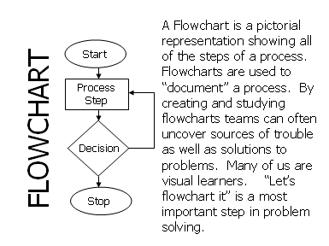
A Few Tools Highlighted
Flowchart/process map

Slide 18
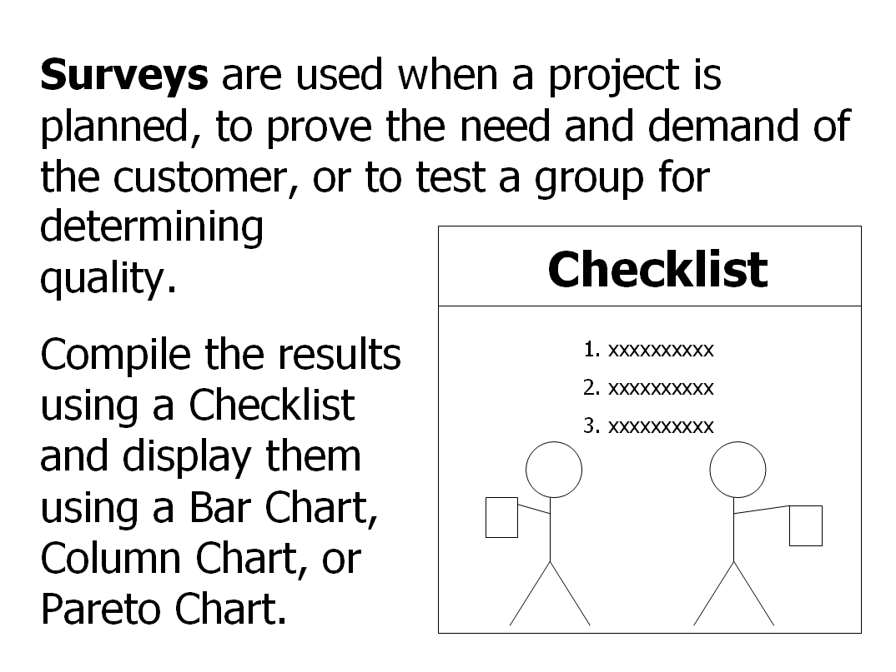
A Few Tools Highlighted (Surveys)
Survey

Slide 19
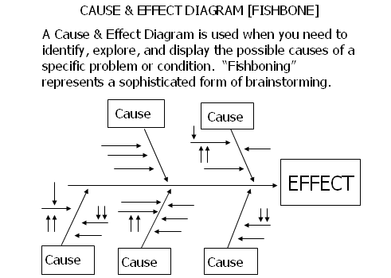
A Few Tools Highlighted (Cause and Effect Diagram)
Cause and Effect Diagram

Slide 20
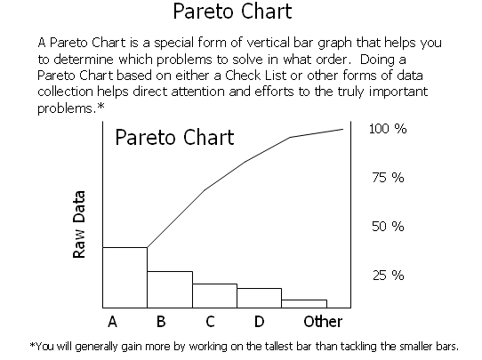
A Few Tools Highlighted (Pareto chart)
Pareto Diagram

Slide 21
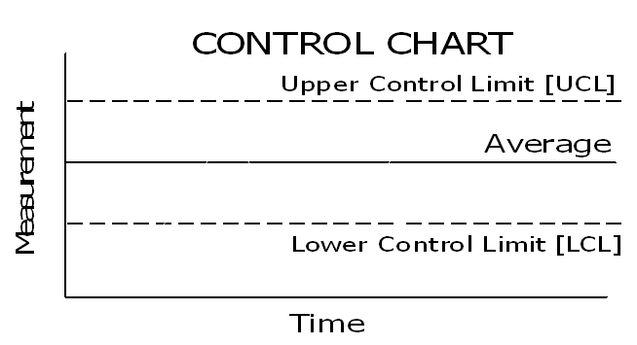
A Few Tools Highlighted (Control Chart)
Process Behavior (or Control) Chart

Slide 22
Developing Measures Effectively
DEVELOPING MEASURES EFFECTIVELY

Slide 23
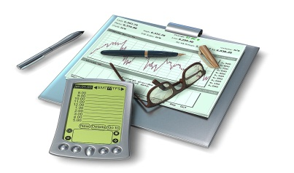
Measures Overview
What is a Measure?
A measure is a means of assessing performance in a particular area.
Why Measure?
Measures are at the heart of a good, customer-focused process management system, and any activity directed at continuous improvement.

Slide 24

Measures
Measures help drive performance improvement.
Measures help provide a basis for assessing efficiency and effectiveness of services.

Slide 25

Measures (Performance Management Plan)
The Performance Management Plan (PMP) has been,
and is a useful tool to plan and take the pulse of an
organization.
The PMP assists organizations with:
  Effective organizational performance measurement
  Implementation of strategy

Slide 26
Measures (Value Proposition)
The PMP focuses on documenting a group’s value
proposition, main operating strategy, and objectives in
four perspectives:
Value Proposition
Customer
Who do we define as our customer? How do we create value for our customer?
Financial
Internal Process
To satisfy customers while meeting budgetary constraints, at what business processes must we excel?
How do we add value for customers while controlling costs?
Strategy
How do we enable ourselves to grow and change, meeting ongoing customer needs
Employee Learning and Growth

Slide 27

Steps to Develop and Manage with Measures

Slide 28
Steps to Develop and Manage with Measures
Link Processes to Objectives
Using the PMP framework, establish a clear understanding of your service group’s purpose, or value, and your objectives. Update as necessary.
Identify linkages between your processes (work that is done) and defined objectives to increase the likelihood that improved process results will contribute to total service group accomplishments.

Slide 29

Steps to Develop and Manage with Measures (Identify)
Identify and Select Performance Measures
Within the objectives, identify what process is being measured, where applicable, and the goals of each process being measured.
Decide how requirements will be met.
Know the purpose of the results.
Understand why the results matter.
Measure that which is most important.
NOTE:
Effective performance measures reflect a strong customer focus.

Slide 30
Steps to Develop and Manage with Measures (Baseline)
Establish Baseline to Compare Future Performance
Baselines are an essential element of performance measurement.
If no baselines exist, select measures that will establish the basis for comparing future performance, collect data about current processes, work output, and service group outcomes.

Slide 31
Steps to Develop and Manage with Measures (Select Processes)
Select Processes with the Greatest Impact
Select those processes, tied to the objectives, within each PMP perspective with the greatest operational impact.
Remember to highlight areas that will allow measurement of key elements of your primary strategy.

Slide 32

Steps to Develop and Manage with Measures (Collect data)
Collect Data
Address data collection during development of measures.
Decide the “what, when, where, how and by whom” of collecting the data and document it.
Validate data.
  Review performance measures to verify they represent what they intend to gauge – Are we measuring the right thing?

Slide 33
Steps to Develop and Manage with Measures (Validate data)
Validate Data (example)
Internal Business Process
Realize efficiencies in key areas

Slide 34
Steps to Develop and Manage with Measures (Collect data cont’d.)
Collect Data (continued)
Document measures using any one of the suggested forms on the next three slides:

Slide 35
Simple Measurement Plan (simple tracking for each measure can be done in MS Word or Excel)
Process:
Measure Type (input, output, efficiency, quality or outcome):
Description: What is the measure capturing The measure is: List the actual measure, e.g., number of, percentage of, etc. The target is: May be baseline, or projections computed against baseline Data Source: Where to get the data Responsible Person/ Component: Who, or which group will collect the data Frequency: How often will the data be collected, and reported on
Date Developed:

Slide 36
Data Collection Plan Template
NOTE: actual template is blank; the content in each column describes what should be filled in.
Available at http://oqm.ors.od.nih.gov/performance_mgmt.htm#templates

Slide 37
Measure Roadmap Template
NOTE: actual template is blank; the content in each box describes what should be filled in.
Available at http://oqm.ors.od.nih.gov/performance_mgmt.htm#templates

Slide 38
Steps to Develop and Manage with Measures (Analysis)
Analyze Documented Results
Examine results in context of the objectives, environment, and external factors.
After analyzing the performance data and information, interpret the information in order to ascertain whether the objectives have been met, and if not, why not.
In cases where the objectives are not being met, develop an action plan to correct this.
  E.g., If feedback indicates that fewer customers are utilizing a new service provided by your service group, note this and make the necessary modifications to improve or tailor the service.

Slide 39
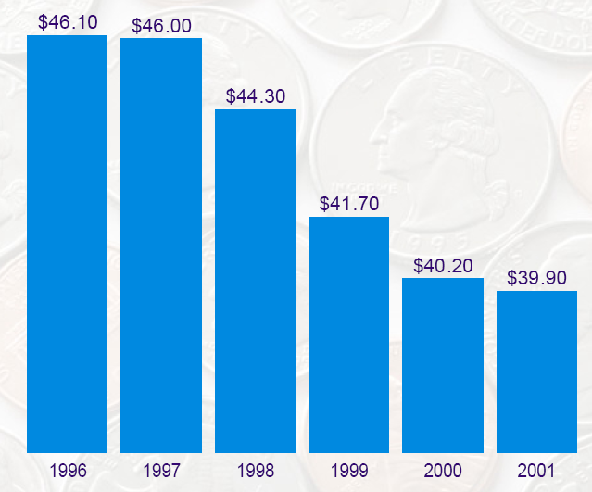
Steps to Develop and Manage with Measures (Communication)
Communicate Results
Graphically display data, using process behavior, pie, and bar charts, or other form to summarize performance rather than narrative alone.
Develop brief updates to share monthly among staff showing monthly progress.
Customer fiscal service
Objective:
Shows cost per customer

Slide 40
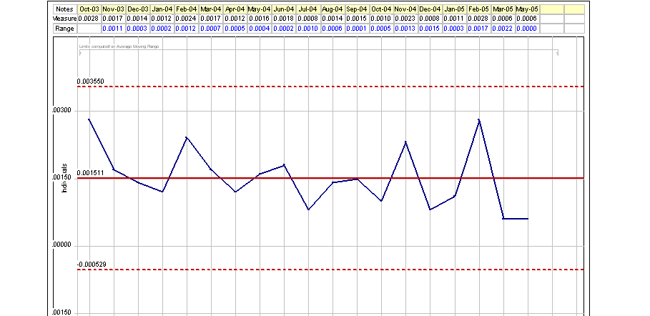
Steps to Develop and Manage with Measures (Communication Ex.)
Communicate Results (continued) : second example
Monthly error rate for sorting incoming mail, October 2003 to May 2005
Shows process is predictable where the expectation is between 0% and .36% error rate
for any month (between 0 and 36 errors per 10,000 pieces of incoming mail).
Note: Data gathered by random sampling.

Slide 41
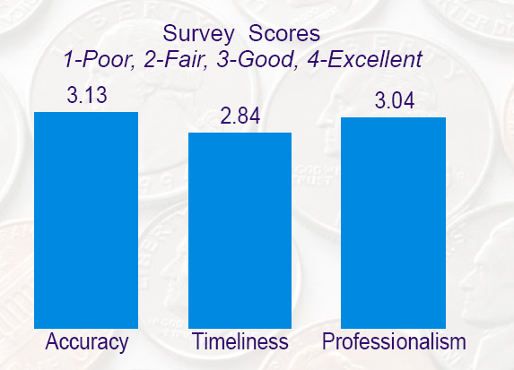
Steps to Develop and Manage with Measures (Communication example)
Communicate Results (continued) : third example
Objective:

Slide 42
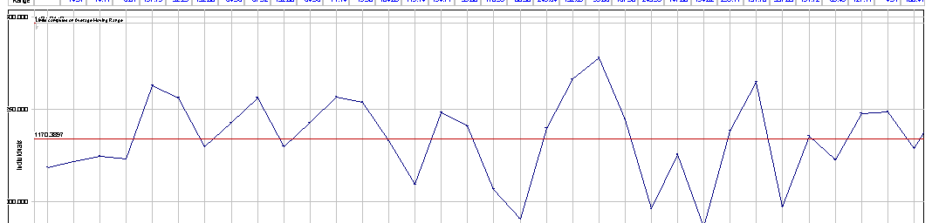
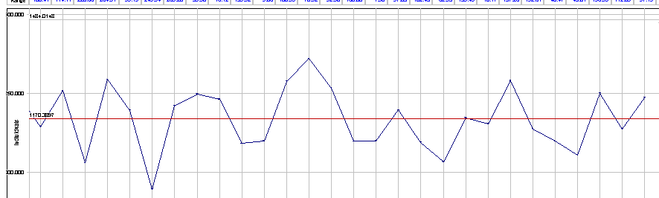
Building X Cafeteria: Daily gross sales from 4/2/2004 to 7/1/2004
4/2/2004
Average Gross sales:$1170.
The lower limit: $857
The upper limit: $1484.
7/1/2004
The process during this period was predictable and the group can expect the
amount of sales to vary from between $857 to $1484, given no substantial changes,
for example sudden menu change or sudden population increase or decrease.

Slide 43
Steps to Develop and Manage with Measures (continued)
Integrate Measurement with Management Processes
The benefit of performance measurement comes from using data to take the appropriate actions to improve performance.
To remaining viable, demonstrate service group value through results.
Integrate results (input, activity, output) into planning, budgeting, and operating processes in the business.

Slide 44
Summary of Steps to Develop and Manage with Measures:
Link Processes to Objectives
Identify and Select Performance Measures
Establish Baseline to Compare Future Performance
Select Processes with the Greatest Operational Impact
Collect Data
Analyze Results
Communicate Results
Integrate Measurement with Management Processes

Slide 45
Managing with Measures
MANAGING WITH MEASURES:
ADDITONAL EXAMPLES FOCUSING ON
STEPS 6 & 7

Slide 46
Customer Perspective
CUSTOMER PERSPECTIVE

Slide 47
Objective and Measures
Service Group: Procure and Deliver Animal Product
Objective
Measure
C1b: Percentage of
procurement orders
C1: Increase
processed within 24 hours
responsiveness to
customers' varying
C1d: Number of complaints
needs
related to responsiveness of
procurement services
C1f: ORS Customer
Scorecard rating for animal
procurement responsiveness
C1b and C1d: These measures are used to drive performance towards reaching an objective. By focusing on each of these measures, the workforce will be taking actions that will satisfy their customers and raise the customer satisfaction scores.

Slide 48
Data Sheet
Automatically Calculated

Slide 49
Output Measure
Output Measure:
% of Procurements Processed within 24 hours (C1b)

Slide 50
Run Chart – (line graph) displays process performance over time
Percentage of procurement orders processed within 24 hours (C1b)
WHAT DOES THIS SHOW?
After a drop in February, there was a steady increase in the % of orders processed in 24 hours. Investigating this phenomenon could unearth an improvement or process change that was instituted. Also, the average line added clarifies movement of the data away from the average.
88
Average = 77.27
68
Range 88 – 68 = 20
For more robust monitoring of the process, and better information about when
the process is showing variation beyond what is expected, try using a process
behavior chart.

Slide 51
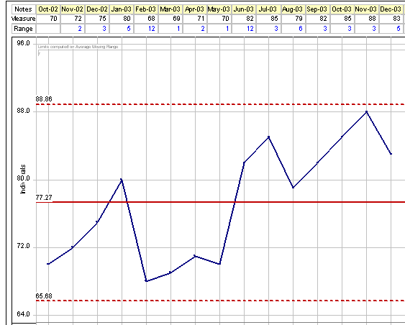
Process Behavior Chart –displays process performance over time and makes it easy see both special and common cause variation in a process
% of orders processed within 24 hours
UCL= 88.9%
AVE=77.3%
WHAT DOES THIS SHOW?
Look at variation over time and show whether an immediate remedy is needed to modify the process or if the entire process should be redesigned.
The process is in control, or predictable, but steps can be taken to improve the process, so that even common cause variation is reduced – for example, explore ways to increase order process efficiency.
LCL=65.7%

Slide 52
Analysis
The Process Behavior Chart (PBC) indicates the average percentage of procurement orders processed within 24 hours is 77.3%.
The PBC indicates that you can expect between
65.7 % and 88.9% of orders will be processed within 24 hours each month unless there is a change to the process.
Is our performance good enough? Are we meeting customer expectations? Refer to baselines and calculated targets, as well as customer agreements and satisfaction ratings.

Slide 53
Measuring Output
Output Measure:
ORS Customer Scorecard ratings for animal procurement
responsiveness (C1f)

Slide 54
Bar Chart – like pie charts, are useful for comparing classes or groups of data
Note: ORS Customer Scorecard graphs are provided in reports generated by the Office of Quality Management (OQM)

Slide 55
Learning and Growth
LEARNING AND GROWTH

Slide 56
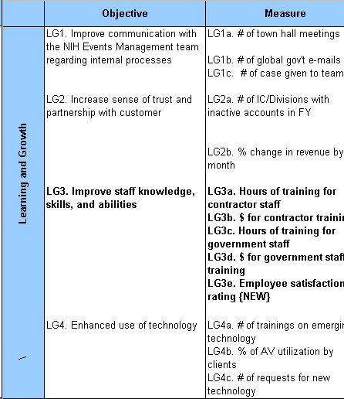
Objectives and Measures
Service Group: Provide NIH Events Management Services

Slide 57
Input Measure
Input Measure:
Measure: Employee Satisfaction Survey Results (LG3e)

Slide 58
Pie Chart – used to show classes or groups of data in proportion to the whole data set.
Employee/Staff Survey Results
Management Questions:
  87% of DEMS staff understand how their job contributes to the mission, vision and values of DEMS
Customer Orientation Questions:
  90% of DEMS staff say DEMS’ services goals are aimed at meeting customer expectations
Teamwork and Innovation Questions:
  93% of DEMS staff feel they can serve customers in a timely fashion

Slide 59
Analysis Methodology
A high percentage of staff feel they understand the organization’s mission, the goals match customer expectations, and they can serve customers in a timely manner.
Lower percentages on the charts should be addressed.
Practical corrective actions should be employed to maintain and/or improve performance.
The information serves as input to the overall service and processes provided by the group; improvement in learning and growth areas drives behavior to achieve objectives.

Slide 60
FINANCIAL PERSPECTIVE
Financial Perspective

Slide 61
Financial Objective and Measures
Service Group: Provide Transportation and Parking Services

Slide 62
Measuring Input
Input Measure:
Minimize the unit cost for providing shuttle services (F3)

Slide 63
Calculation Example
Minimize the unit cost for providing shuttle services (F3)
Note: Estimate that budget for patient shuttle is 30% of total budget for the discrete service; budget to employee shuttles is 70% of budget for the discrete service.

Slide 64
Analysis Example
Determined the basic unit of service delivery – number of riders
Counted the number of riders on shuttle – this becomes the denominator for the unit cost formula
Determined the dollar resources expended in providing shuttle service – this becomes the numerator of the unit cost formula
The ratio of numerator ($) divided by denominator (riders) yields cost per rider on the shuttles
Use this and other data to reveal methods to maintain (or if possible lower) the “unit cost” – example is to encourage more riders - lowers unit cost ( reason: more riders for same resources)

Slide 65
Integrating Data into Business Management
Integrating Data into Business Management

Slide 66
Questions to integrate performance data into
Business Management:
  How can the performance data be used to improve business decisions?
  Examine data for trends over time and across functions. What do the results mean? Do the results contribute to goals and objectives?
  Have the right measures been included in the PMP? Does the PMP reflect our priorities?
  Are the performance results helping the manager make better decisions? If not, notify the team or individuals that are responsible about the data that is needed.
  If the performance results exceed the targets, how can the service group take advantage of additional benefits to improve service and reduce operating costs? What opportunities do the additional benefits make possible?

Slide 67
Questions to integrate performance data into
Business Management (continued):
  What is the level of customer satisfaction?
  If the results fall short of the targets, what inhibited performance? Were the inhibitors technical or organizational in nature?
Source: Performance Based Management, P. Plunkett

Slide 68
Summary
Make sure your objectives reflect your value proposition and strategy.
Link measures to objectives.
Tools such as the data collection plan and measure roadmap help in being systematic in data collection.
Additional help on analysis of data, charts, and graphs can be provided by OQM (e.g., Process Behavior Chart training, FY02 Data Analysis Training).

Slide 69

Thank You
Thank You.
For more information on Performance Management in the Office of Research services:
http://www.ors.od.nih.gov/OD/OQM/Pages/index.aspx
Acknowledgments
This training was developed by the Office of Quality Management.

