Slide 1
Process Mapping
Antonio R. Rodriguez, Director
OFFICE OF QUALITY MANAGEMENT

Slide 2
Training Objectives
Become familiar with important concepts of process mapping
Identify different types of process maps (PM)
Describe the benefits of different PM
Recognize the role of process mapping in the NIH Risk Management Program
Construct a deployment flowchart
Identify measurement opportunities in a process map
Explain how process maps can be utilized to improve process and output performance

Slide 3
What is a process?
A process is a series of steps that transform inputs to outputs
  Inputs to a process include materials, methods, information, people, equipment, the work environment
  Outputs of a process are products and services
Everything you do in the workplace is part of a process

Slide 4
Why Is It Important to Understand Processes?

Slide 5
Why do we care about processes?
Outputs (products and services) are developed using processes
Understanding the underlying process is key to improving performance and the quality of outputs
Inputs are outputs of previous processes
Quality inputs and processes are necessary for quality outputs

Slide 6
Overview of a Process
SUPPLIER
INPUTS
PROCESS
OUTPUTS
CUSTOMER
OUTCOMES
People
Machinery
Material
Methods
Information
Environment
Products
Services

Slide 7
What are process maps?
Pictures of the flow or sequence of activities and decisions that result in a product or service
Can be applied to any set of activities
  Ordering slides and posters
  Paying invoices on time
  Conducting space planning
  Coordinating research collaboration
  Evacuating a building or the campus
  Training
  Responding to a protest
Process maps are also known as flowcharts

Slide 8
What do process maps do?
Allow a team to come to agreement on the steps needed to produce outputs
Assist in examining which activities have the greatest impact on process performance
Show unexpected complexity, problem areas, redundancy, unnecessary loops
Identify where data can be collected and analyzed to meet a specific purpose
Serve as a training aid to understand the complete process
Compare the actual process against an ideal process
Identify changes that may bring about improvement
Adapted from Brassard & Ritter, 1994.

Slide 9
What do process maps do? (cont.)
Promote understanding of the relationship of a process to a larger system or vice versa
  Input of materials, services, or information from suppliers
  Hand-offs between different work units
  Delivery of the output to customers
  Constraints set by laws, rules, regulations, or budgets
Help to identify boundaries processes cross
  Processes usually cut across organizational units
  People rarely see, participate or understand the entire process
  Process maps help people “see” the whole process

Slide 10
Types of Process Maps

Slide 11
Three Common Types of Process Maps
Block Diagrams
Linear Flowcharts
Deployment Flowcharts

Slide 12
Block Diagrams
Depict the process with the fewest details
Provide a picture of high-level flow of a process
Show key action steps but no decision diamonds
Generally have only four or five steps
Offer a “10,000 foot” view of the process

Slide 13
Example
Block Diagram
NIH Evacuation
Initiate OEP
Activate Evacuation Signal
Evacuate Building/ Campus
Emergency Happens
Notify Fire Department
OEP – Occupant Evacuation Plan

Slide 14
Basic Process Map Symbols
Process Start/End
Ovals mark the first step and the final step of the process
Squares/rectangles represent a particular step or activity in the process
Diamonds show “yes-no” decision points
Circles with letters or symbols specify subroutines or connecting points; empty circles show cooperation points
Arrows show the flow, or movement, of the process from one step to the next
Process Step
Decision
A

Slide 15
Linear Flowcharts
Constitute a simple form of a process map
Provide an overall picture of activities required
Can create a foundation for other types of flowcharts
Can be completed at different levels of detail
Generally have eight to perhaps twelve steps, including decisions
Offer a “5,000 foot” view of the process

Slide 16
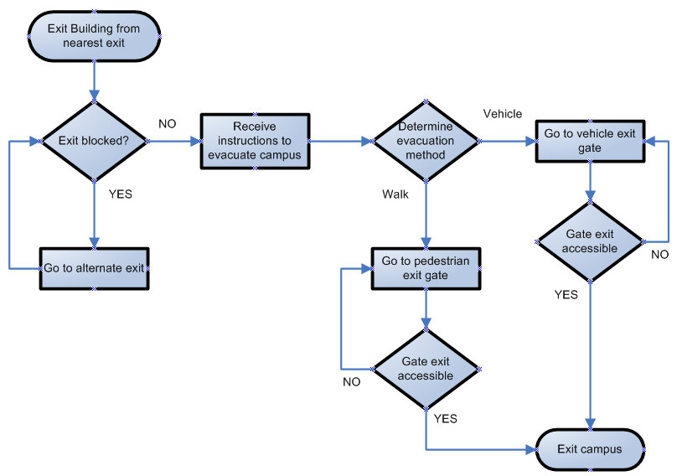
Example
Linear Flowchart
Campus Evacuation Process

Slide 17
Deployment Flowcharts
Provide more information about processes
Map what happens in a process and who is responsible for each step
Communicate the interrelationships, sequence of operations, decisions required, to transform inputs into products and services
Useful to:
  Indicate dependencies in the sequence of events
  Clarify roles and hand-offs
  Track accountability
  Compare workloads and identify bottlenecks within a process when used in conjunction with data

Slide 18
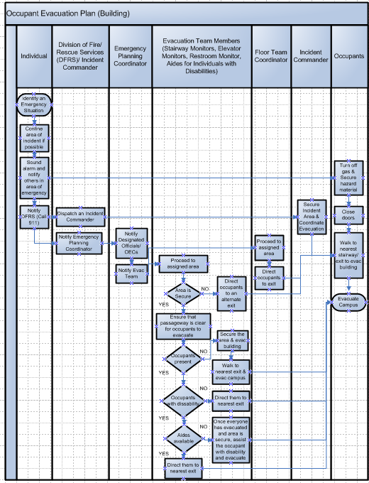
ORS Example
Deployment Flowchart - Evacuation Process

Slide 19
Advantages of Deployment Flowcharts
Processes usually extend beyond the borders of a single work unit
Work groups usually only “see” the steps in their organizational unit
People working on one part of the process often don’t communicate with those in other parts
Deployment flowcharts are the best way to remove the mystery
They provide the most amount of detail – a “100 foot” view of the process
See The Memory Jogger II (Brassard & Ritter, 1994) for more information about flowcharts.

Slide 20
Utilizing Process Mapping in Support of the
NIH Risk Management Program

Slide 21
NIH Risk Management Program
The NIH Risk Management Program (RM Program) is an ongoing process to perform standardized repeatable activities that promote the overall efficiency, effectiveness, accountability and integrity of the organization’s work
Overarching Goal is to employ proactive risk management to enhance program performance
Six-phased methodology that provides a standardized means of addressing risk at NIH.
NIH Risk Management Program Guidebook and other resources available at:
  http://oma.od.nih.gov/

Slide 22
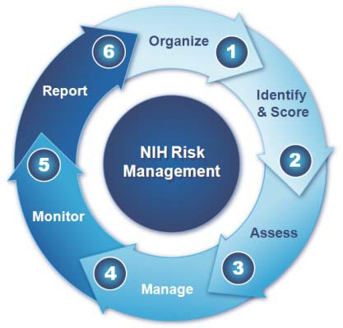
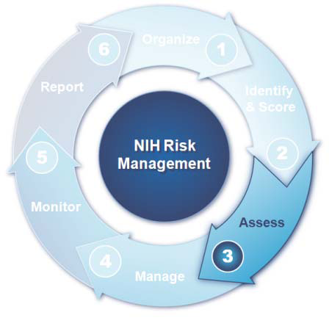
NIH Risk Management Approach

Slide 23
Risk Management - Terminology
(pertinent to the Assess Phase)
Control
  a mechanism to prevent or reduce the likelihood of a risk occurring, or
  an activity to reduce the impact of a risk should it occur.
Key Control
  a control that management relies most heavily on to ensure a process operates correctly.
Control Gap
  Exists when a portion of a process lacks an appropriate control
Design Deficiency
  Exists when a control is executed as intended but does not meet the objective of mitigating a risk
Operating Deficiency
  Exists when a properly designed control does not operate as intended, or when the person performing the control does not possess the necessary authority or qualification to perform the control effectively

Slide 24
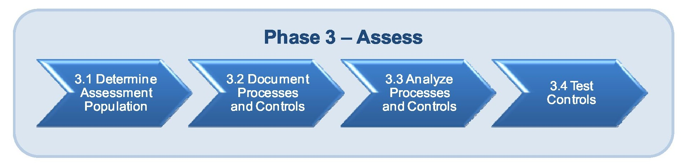
Risk Management - Phase 3 - Assess Phase
Purpose of the Assess phase is to evaluate the effectiveness of the processes and controls associated with identified risks
Each Assessable Unit (AU) is responsible for conducting control assessments on risks the Risk Management Officer (RMO) selects from the AU risk inventory
  A control assessment evaluates the effectiveness of the processes and controls associated with an identified risk
Information contained in Risk Management Program Guidebook considered best practice for conducting a control assessment

Slide 25
Risk Management - Phase 3 Assess Phase
3.1 Determine Assessment Population
  Identification of which risks will undergo a control assessment
3.2 Document Processes and Controls
  Create process flows to identify control points and associated control activities
3.3 Analyze Processes and Controls
  Identification of key controls,
  Identification of potential design deficiencies, and
  Determination of control gaps.
3.4 Test Controls
  Testing of operating effectiveness of each control
* More detail can be found in the NIH Risk Management Program Guidebook

Slide 26
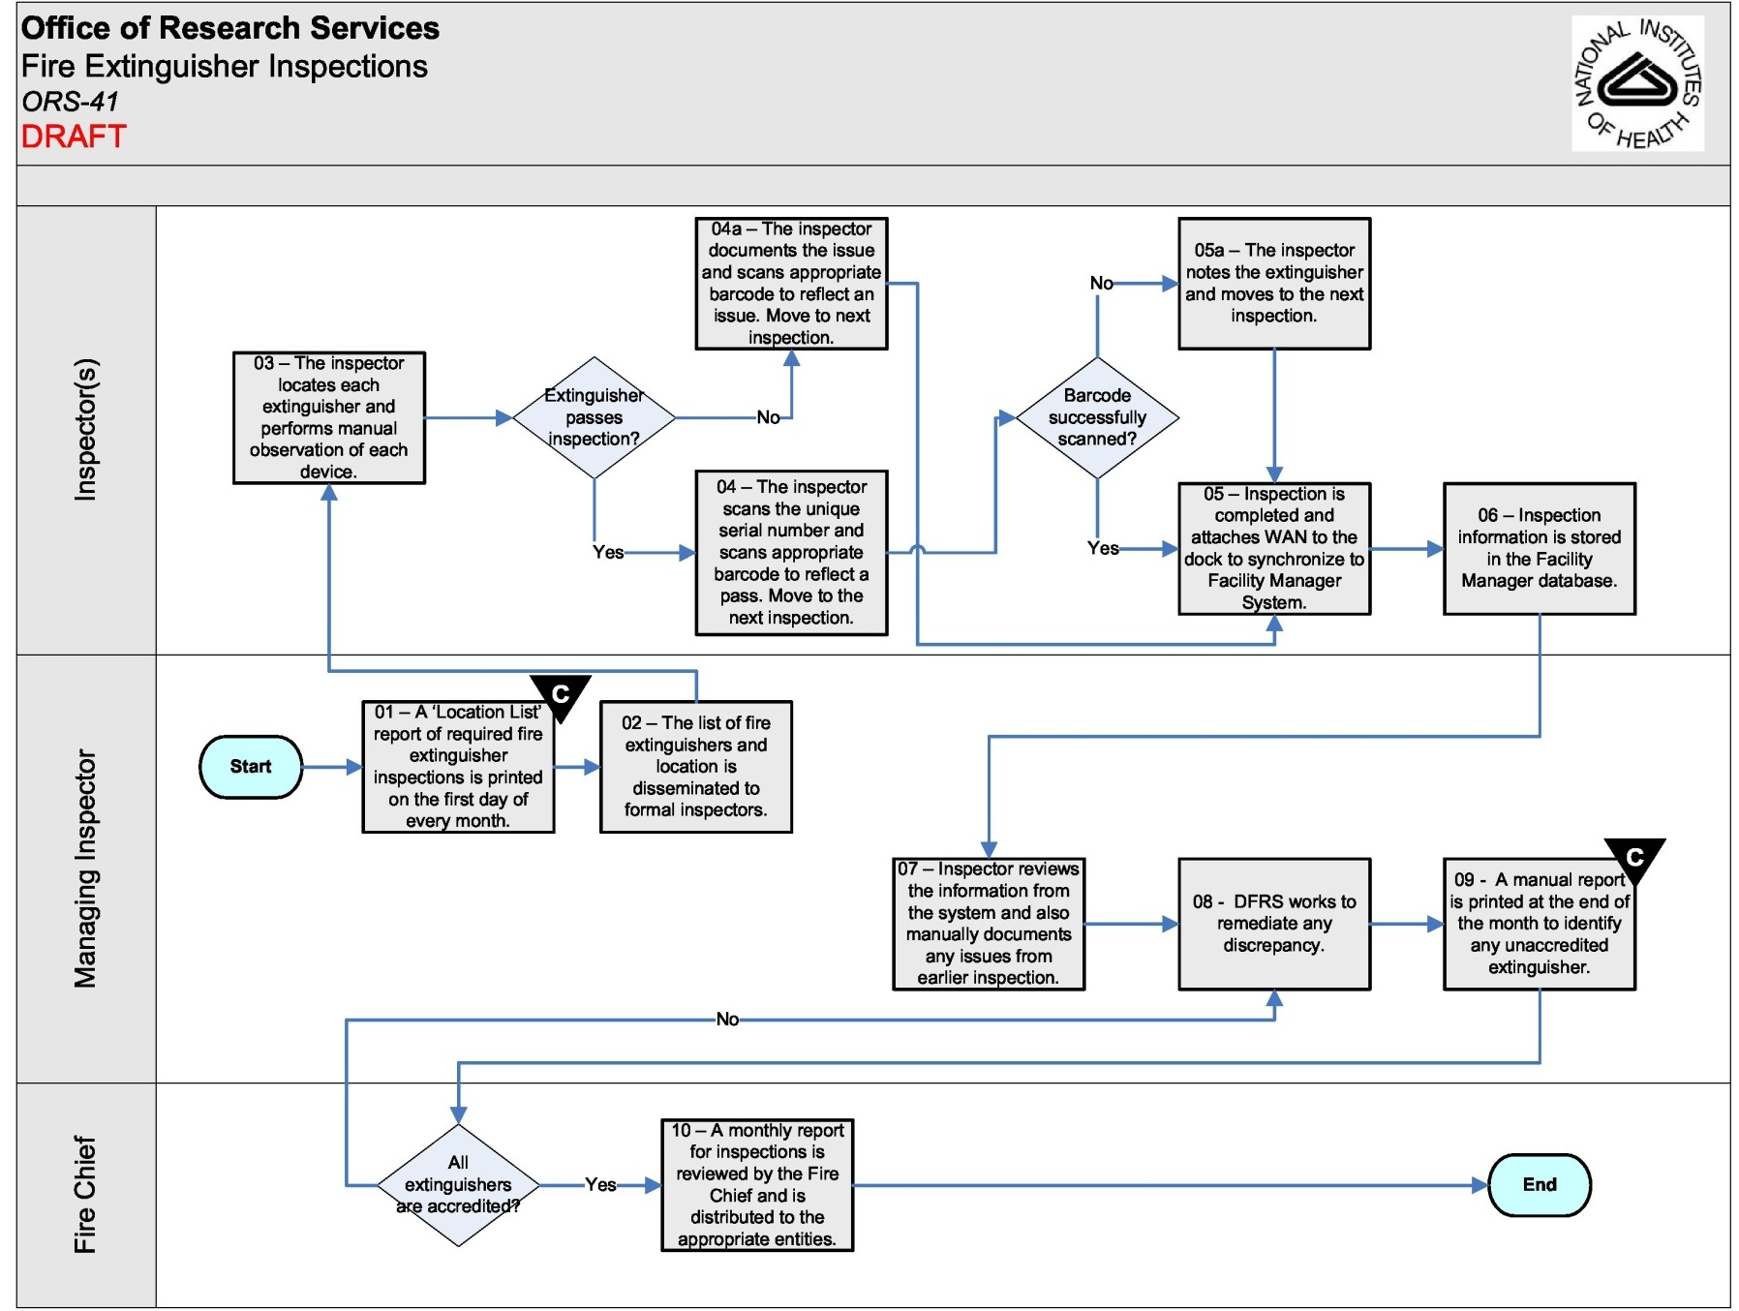
Risk Management Example (see handout)
ORS Fire Extinguisher Inspections
Risk Statement: If NIH does not have adequate procedures in place to ensure fire extinguishers are regularly inspected and maintained in operating condition, then a fire incident will have a greater likelihood of causing loss of life or property at NIH.

Slide 27
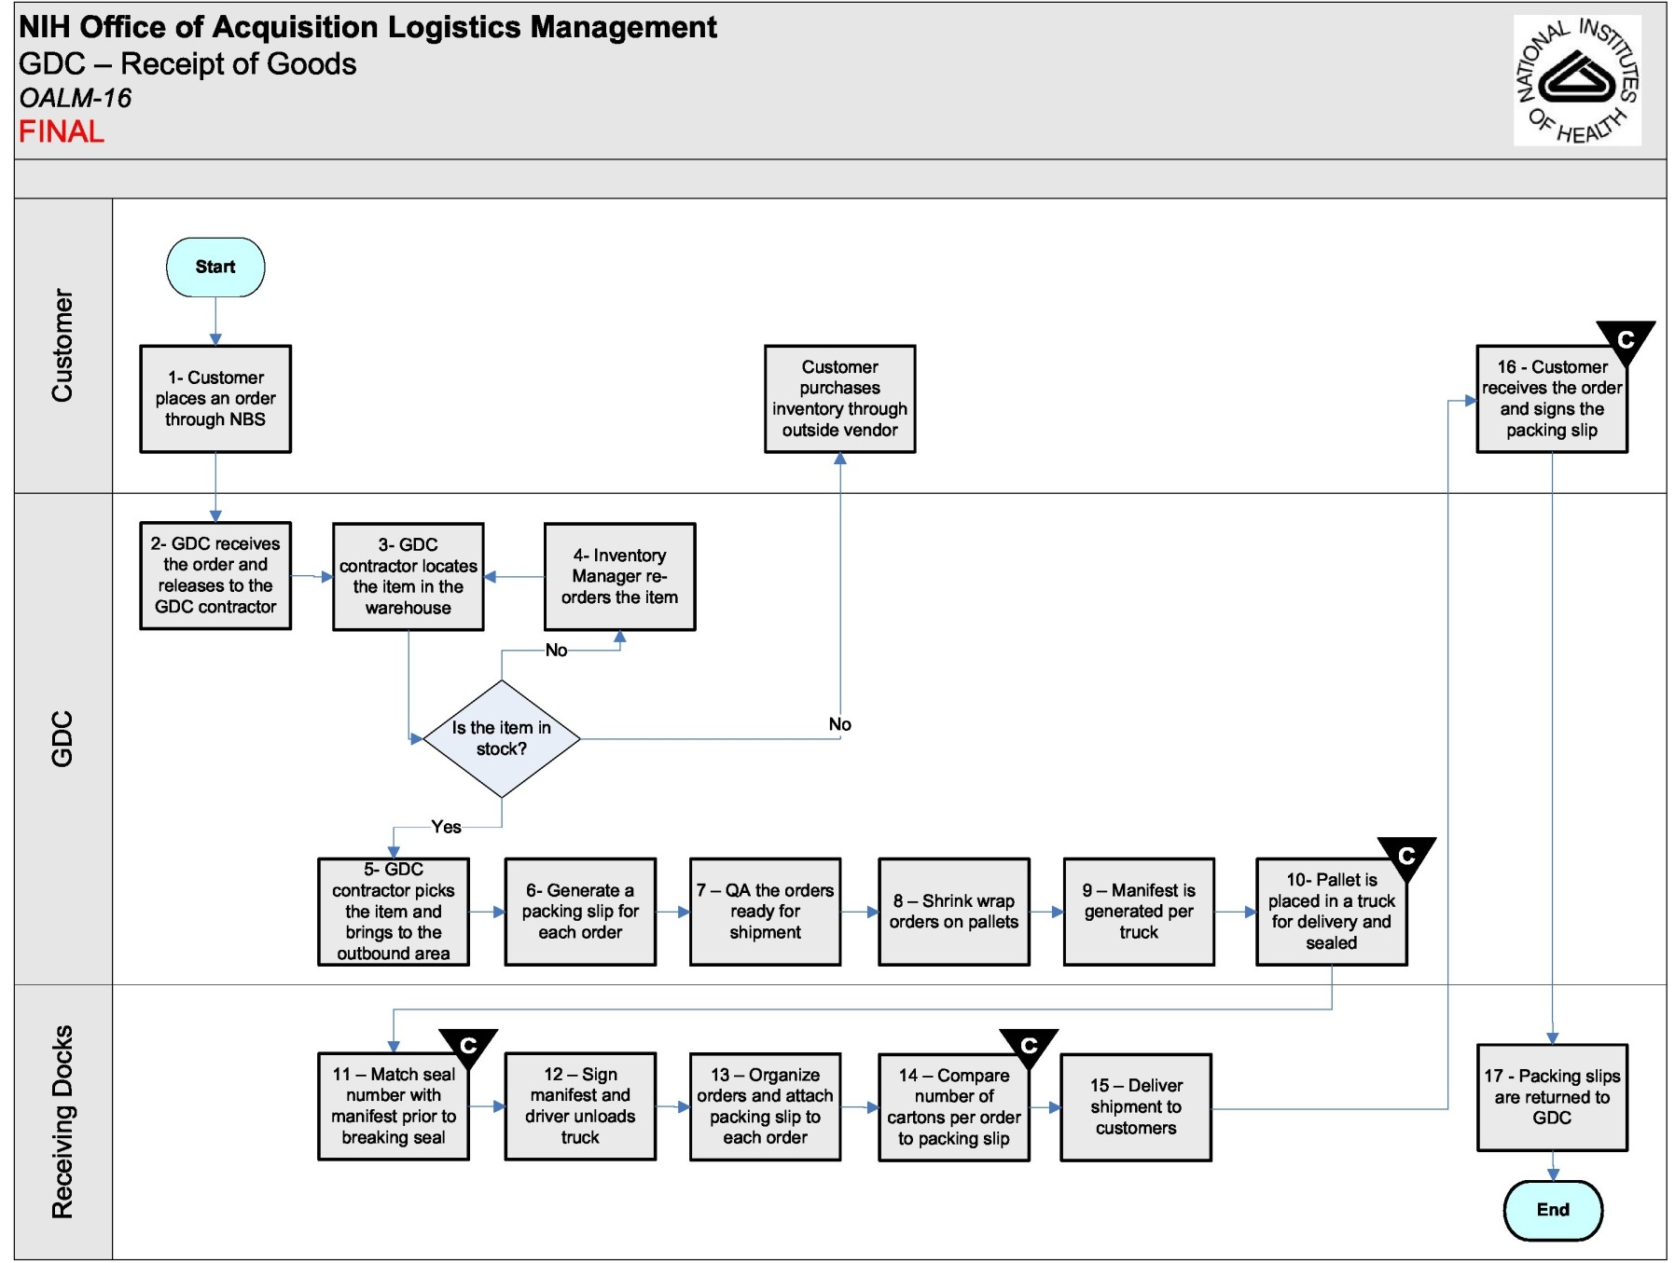
Risk Management Example (see handout)
OALM/GDC – Receipt of Goods
Risk Statement: If NIH does not have adequate receiving procedures in place for goods shipped from the GDC warehouse, then NIH may incur financial loses and disruptions to research activities due to lost or stolen supplies.

Slide 28
Creating A Deployment Flowchart

Slide 29
Tips for Developing Flowcharts
Don’t get bogged down in too much detail or debate
  Start with the big picture
  Maintain a consistent level of detail (depth) throughout
  Brainstorm steps and decisions and later organize in sequence
There may be no ONE right process map
  Processes may operate in different ways
  People have different perspectives on how the process flows
  Have a way to handle the differing views of team members
    Document all differences and decide later the standardized approach

Slide 30
Tips for Developing Flowcharts (cont.)
Keep your arrows straight
  Usually a process map is easier to read if curved arrows are avoided
Strive to have symbols with one arrow going in and one arrow going out
  Rule doesn’t apply to decision diamonds
    One arrow going in, but –
    Two arrows going out
      One for “yes”
      One for “no”

Slide 31
Creating a Deployment Flowchart - Steps
Step 1: Label the Process Map
Step 2: Determine the Frame or Boundaries
Step 3: Identify the Players in the Process
Step 4: Determine the Steps in the Process
Step 5: Sequence Steps/Show Responsibility
Step 6: Draw the Process Map
Step 7: Check the Process Map
Step 8: Prepare the Process Map in Visio
Step 9: Review and Revise the Process Map

Slide 32
Step 1: Label the Process Map
Process mapping can be valuable at any level
  Discrete Service level (output level)
  Service Group level
  Work unit’s activities
  Individual worker’s tasks
Agree on what you will be mapping
Determine what level of detail you wish to capture
  Identify the question of interest, problem, or opportunity pursued
  Proceed to more detailed charts as needed
Label the process map with:
  Title of the process
  Date the map is being created
  Names of those who are contributing to the map
Steps adapted from Brassard & Ritter, 1994.

Slide 33
Step 2: Determine the Frame or Boundaries of the Process
The purpose of this step is to identify how broad or narrow the process analysis effort will be
Where the group decides the process begins and ends determines the focus for studying and measuring the process
Define where the process starts
  How does this process begin?
  What happens to initiate or kick off the activities in this process?
Define where the process ends
  How does this process end?
  What is the final step or activity required to deliver the product or service?

Slide 34
Step 3: Identify the Players in the Process
Identify all key “players” in the process
  Use Division/Office/Branch designations and/or position titles if possible, rather than people’s names
  Include people who handle steps prior to you – these are your internal suppliers
  Include people who handle steps after you – these are your internal customers
List each “player” on its own Post-It® and place horizontally across the top of the flowchart

Slide 35
Step 4: Determine the Steps in the Process
Describe the activities that transform inputs into outputs
Map the ACTUAL process the way it occurs now
  Not the ideal process (the way it should occur)
  Not the formally documented process (the way the SOP says it happens)
Consider the following:
  What major activities occur in this process?
  Where do decisions need to be made or approvals occur before the next step?
  What causes extra work or rework in this process?
  Are there places where more than one method is occurring?
  What factors inhibit process members from performing well?
List each step on its own Post-It® and place vertically

Slide 36
Step 5: Sequence the Steps and Show Responsibility
Arrange the steps in the order in which they occur
Place each step under the name of the office or position with primary responsibility for accomplishing it
Where more than one player is required to participate in a step, indicate this with a blank circle placed in the appropriate column
Rearrange steps and players as needed, until they accurately show how the process flows

Slide 37
Step 6: Draw the Process Map
Assign the correct flowchart symbols to each step
Review the process flow
  - Add steps if missing
  - Reorder steps if needed
Show the flow of activity between steps with arrows
Show shared responsibility for a step with circles and lines
Provide a symbol key at the bottom (or on the last page) of the flowchart

Slide 38
Step 6: Draw the Process Map (cont.)
Process Start-End
Ovals (or round-corner rectangles) show the process start
Ovals (or round-corner rectangles) show the process end
Process Start
Process End

Slide 39
Step 6: Draw the Process Map (cont.)
Process Steps
Rectangles or squares show a step, activity, or task in the process
When several steps feed into one, join the activity lines so that only one arrow goes into the next box
Where you have more than one arrow coming out, substitute one or more decision points
Process Step
Process Step

Slide 40
Step 6: Draw the Process Map (cont.)
Process Decision
All decision questions are indicated by a diamond
Most decision diamond questions are answered yes or no, and are followed by yes-no arrows
You may need a series of activities and decisions to show complex decision points as yes-no choices
Try to show all “yes” arrows going downward from each decision point
Try to show all “no” arrows going either out from the left or out from the right of each decision point
Decision?

Slide 41
Step 6: Draw the Process Map (cont.)
Multiple Players
Use a blank circle to show steps where coordination, cooperation, or communication is required among several players
Connect blank circles to their steps with straight lines (no arrow head)

Slide 42
Step 6: Draw the Process Map (cont.)
Process Continuations
Use letters or numbers in a circle to indicate a break in the flowchart
Provide the continuation or more detailed information on another page or where appropriate
Label the continuation page, or page with more detailed information, using the same symbol used on the original flowchart
A

Slide 43
Step 7: Check the Process Map
Are symbols used correctly?
Are process steps clearly described?
Does every path take you either back to or ahead to another step?
Does the chart accurately depict what really happens?
Have you labeled your flowchart and provided a key?

Slide 44
Step 8: Prepare the Process Map in Visio
ORS has site license
  Check with your AO to confirm license availability in your Branch
  Contact CIT for installation on your desktop
Prepare your flowchart in Visio (or another software if you already have it).
  Limit map to one or two pages if possible
    Best if not too detailed the first time around
    One or two pages are easier to review and discuss with others
    Can have more detailed flowchart as back-up if desired
    Add details or breadth as needed
  But don’t sacrifice sense or understanding in favor of saving space/paper

Slide 45
Step 9: Review and Revise the Process Map
Provide team with print-out of the process map and discuss
  Is this process operating the way it should be?
  Does everyone really complete the activities as shown here?
  Are there obvious places where the process could be simplified?
  How different is the current process from the ideal process?
  How can this process be improved?
Show the process map to others and get their feedback
  Internal suppliers
  Internal customers
  Management staff

Slide 46
Process Mapping Exercise

Slide 47
Process Mapping Exercise
Directions
You will have 30-45 minutes
Do activity as a team if possible – otherwise do your own Discrete Service
Write Service Group or Discrete Service (or other work process) on Post-Its® and place on wall
List players
  Record on Post-Its®
List process start, end, and activity steps/decisions
  Record on Post-Its®
Arrange players horizontally and place steps vertically
Draw arrows
Check process map to ensure you have not missed any steps
Remember to depict the process as it occurs now

Slide 48
Process Mapping Exercise (cont.)
Feedback
How did it go?
What were your biggest challenges?
Did you identify any obvious problems or opportunities?
What did you learn?
Do you have any questions?

Slide 49
Process Measures/Indicators and
Process Improvement

Slide 50
Process Maps Help Identify Measures/Indicators of Performance
Process mapping helps identify where and what to measure
  Depicts how process currently works
  Helps to figure out where to set up measures
  Tool to begin studying the process
Other methods to study and measure processes include:
  Cause-and-effect diagrams
  Pareto charts
  Process modeling and simulation
  Process behavior charts

Slide 51
What are process measures or indicators?
Observation or review points that provide insight into how effectively and efficiently processes are working (e.g., extent to which we are providing value, length of time, errors, cost)
May be difficult to identify initially
Once the process is mapped, it will be easier to identify where process data are needed

Slide 52
Why do we need process measures or indicators?
Serve as the basis to understand the performance of the process over time
Show the occurrence and extent of problems in the process
Assist in diagnosing process inefficiencies
Help to determine why problems occur
Help in identifying how to make process improvements
Allow for the study of the interrelationships between events and among players in the process
Gauge the results of changes made to the process

Slide 53
How can process measures lead to performance improvement?
Process measures are a key component of the process improvement cycle
  Cycle created by Dr. Walter Shewhart from Western Electric (now Bell Labs)
  Plan-Do-Check-Act (PDCA) cycle, now generally referred to as Plan-Do-Study-Act (PDSA) or the Deming cycle
  Application of the scientific method to management
Process measures/indicators are necessary in continuous improvement
  Customer needs and expectations always change
  Need systematic way to measure and make improvements
  PDSA cycle guides this process
See The Team Handbook (Sholtes, 1988) and Building Continuous Improvement (Wheeler & Poling, 1998) for more information about process improvement.

Slide 54
The PDSA Cycle – Plan-Do…
Plan
  Describe the improvement you seek, how you will make the changes in your processes to bring about the improvement, and how you will measure the improvement
Do
  Implement your improvement plan, preferably testing it on a trial basis first

Slide 55
The PDSA Cycle - …Study-Act
Study
  Collect data on your improvement effort and study the results of your improvement actions. What occurred? Why?
Act
  Take action on what you learned in the previous stage:
    Adopt the improvement for broader implementation
    Adjust your improvement plan and try again
    Abandon the effort because the benefits do not outweigh the cost of improvement

Slide 56
The PDSA Cycle
Act
Adopt on a large scale
Adapt
Abandon
Plan
Set hypothesis
Validate causes
Plan a test
A
P
Study
Collect data to verify improvement
Do
Test on small scale
S
D

Slide 57
Using Process Maps to Identify Measures
Review process map and look for:
  Endless “do-loops” where rework is common
  Activity flows that go back and forth repeatedly between players
  Redundant activities
  Unnecessary process steps
  Role or responsibility ambiguity
  Activity time (lapse of time to complete a given step)
  Cycle time (total time elapsed from first to last step)
  Delays between steps
  Bottlenecks (backlogs) in the process (when used together with data)
Segment and group the steps of the process map and select an appropriate measure for each segment
Look at decision diamonds and measure the reasons that take the process through the “no” arrow
Complete a causal analysis on the inputs to your process
  Determine whether one input or another is generating problems

Slide 58
Example
Identifying Process Measures
Elapsed Time
Cost of
Activity
Proportion
Rejected
Duration
of Activity
Yes
Prepare
Final Report
Compile Information
Prepare
Report
Acceptable?
Distribute
Report
No
Reasons of Rejection
Quality of Output Activity
Inaccurate Incomplete Late Rambling Grammar
xxxxx xxxxx xxx zzzzz xxxxx
xxxxx xxxxx zzzz xx
xxxxx
xx

Slide 59
ORS Examples of Process Measures
Cycle time from customer request to providing service
(e.g., Locksmith)
Time between customer order and delivery of product
Number of unscheduled repairs
Percent of billing transactions processed with errors
Percent of notification memos sent out within 1 week
Problem resolution time of help desk requests
Number of facility deficiencies
Percent “errors” found in radioactive materials inventory
Type and location of occurrence of security violations

Slide 60
Evaluating Process Measures/Indicators
What data could be used to measure, or as an indicator of performance?
Is the data currently being gathered? If not, would it be difficult to collect? If yes, is it valid and precise?
How strong is the relationship between the measure/indicator and the results we are trying to achieve?
How costly is it to collect and use the data?
Who will use this data, and how?

Slide 61
Next Steps
Identify appropriate people to attend your process mapping working session
  Make sure all key players are represented
  Include those who are closest to the actual work if possible
  Invite others (manager, supervisor, customer) who may wish to learn about the process flow
Complete process maps of:
  Each Discrete Service
  Your Service Group
  Key business processes within Service Groups
Prepare maps in Visio
Analyze maps and identify:
  Process measures
  Low-hanging fruit (i.e., quick fixes)
  Other, longer-term improvements
Complete a process improvement plan
Gather process measures data
Analyze process and other performance data
  Attend Data Analysis and Graphing Training
  Attend Process Behavior Charts Training

Slide 62
Conclusion
Process mapping is a basic but powerful tool
Provides the basis for performance improvement
  Helps identify process measures
  Reveals some process problems right away (e.g., complexity, redundancy, rework, gaps, too many approvals/inspections)
Encourages teamwork
  Need others to accurately depict the process
  Helps identify hand-offs between people or organizations
  Clarifies roles and responsibilities
  Builds a sense of working together towards a common goal
Foundation for product and service improvement

Slide 63
References
Brassard. M. (1995). The Team Memory Jogger. Methuen, MA: GOAL/QPC.
Brassard, M.; & Ritter, D. (1994). The Memory Jogger II. Methuen, MA: GOAL/QPC.
Scholtes, P. (1988). The Team Handbook. Madison, WI: Joiner Associates Inc.
Rodriguez, A. R.; Landau, S. B.; & Konoske, P. J. (1993). Systems Approach to Process Improvement. San Diego, CA: Navy Personnel Research and Development Center.
Wheeler, D. J., & Poling, S. R. (1998). Building Continual Improvement. Knoxville, TN: SPC Press, Inc.

