Slide 1
Position Designation Tool (PDT)
Job Aid for NIH
March/April 2020
ORS Office of the Director | ors.od.nih.gov

Slide 2
PDT
OD
The Position Designation Tool (PDT) is the required method to determine the correct background investigation for a position.
The tool is maintained by the Defense Counterintelligence & Security Agency (DCSA) in DOD.
The PDT provides the ability to identify any national security or public trust responsibilities associated with a position.
The link to access the PDT is https://pdt.nbis.mil/
DCSA PDT Training Course: https://www.dcsa.mil/mc/tec/upcoming_courses/
In the NED 5.2 release, a copy of the PDT must be uploaded to NED.
Individuals responsible for designating positions are encouraged to attend formal PDT training offered by DCSA.
AOs are encouraged to work with HR, supervisors, contracting officers, etc. to accurately complete the PDT.
DPSAC in partnership with the NED Team will be offering training and job aids to the AO community.
ORS Office of the Director | ors.od.nih.gov
Notes:
The Defense Counterintelligence and Security Agency in conjunction with the Office of Personnel Management developed the PDT tool to ensure a systematic, dependable and uniform way of designating federal government positions.

Slide 3
Regulatory Guidance
OD
Per Parts 1400 and 731 of Title 5, Code of Federal Regulations, agencies are required to demonstrate adherence to the standards for proper designation of positions
The PDT is designed to ensure a systematic, dependable, and uniform way of designating federal government positions
Proper position designation is the foundation of an effective and consistent suitability and personnel security program and is in line with DPSACs mission to reduce the potential for abuse of public trust
Parts 1400 and 731 of Title 5, Code of Federal Regulations establish the requirements for agencies to evaluate relevant covered positions for a position sensitivity and position risk designation commensurate with the duties and responsibilities of those positions.
ORS Office of the Director | ors.od.nih.gov
Notes:
According to federal regulations, agencies are required to adhere to the standards of proper designation by using the PDT tool to designate the sensitivity and risk of federal government positions, and calculate the corresponding background investigation requirement

Slide 4
What Positions require a PDT at NIH?
***Position Designation is not to be confused with Emergency Tier Designation***
All positions that require logical (account) and/or physical access to NIH that are subject to a background investigation must be designated using the PDT.
For federal contractor/non-Federal positions, the designator must assess the duties the position will be performing on behalf of the Federal Government and not those performed on behalf of the contract employer.
If the individual completing the PDT is not sure which selections within the PDT are applicable, they should contact the supervisor or project officer who will be providing oversight for the position.
Notes:
Includes all positions requiring access to NIH facilities and information systems for 6 months or longer.

Slide 5
Position Designation System
Developing a familiarity and understanding of the underlying logic for the Position Designation tool, Position Designation System (PDS), is essential
The success and consistency of the PDT are connected to the user's understanding of the various possible selections related to the national security and public trust requirements within the Position Designation System.
It is recommended that individuals completing the PDT use the Position Designation System as a reference guide
The PDS is accessible here: https://www.opm.gov/suitability/suitability-executive-agent/position-designation-tool/position-designation-system-with-glossary-2017.pdf
Notes:
Before using the PDT, designators should first develop a thorough familiarity and understanding of the PDS.
The success and consistency of the PDT are directly connected to the user's understanding of the various possible selections related to the national security and suitability (public trust) requirements, duties, and responsibilities available within the PDS.
Without fully understanding the possible selections available, the users could inadvertently fail to make appropriate selections early in the PDT process, and this would impact the accuracy of the final position designation. A full understanding of the PDS and proper application of the PDT will ensure consistency.
The PDS is the underlying logic within the Position Designation Tool that contains all the various possible selections related to the national security and public trust duties, responsibilities and requirements

Slide 6
Position Designation Responsibilities
Individuals completing the PDT must carefully evaluate the Position Description (or equivalent) and any other position information to:
Assess the nature of the position as it relates to the potential material adverse impact to the national security, or public trust
Determine the proper designation and required level of investigation
Individuals who may be responsible for completing the PDT at NIH may include:
NIH Office of Human Resources (for Federal Staff)
Contract Officers Representatives, Project Officers or Administrative Officers (for non-Federal Staff)
Notes:
Individuals completing the PDT must carefully evaluate the Position Description (or equivalent) and any other position information to assess the public trust and national security responsibilities associated with the position.
Examination of the Position information to include position description is critical to assess the nature of the position as it relates to the potential material adverse impact to the national security and on the efficiency or integrity of the service.

Slide 7
Position Designation Steps
Use of the PDT consists of a four-step process that guides the designator through an examination of the position’s duties and responsibilities
The completion of the PDT process will result in a final designation for the position which, in turn, will determine the investigative requirement for the position

Slide 8
Position Designation Steps
Position Designation Process:
Examine and select the National Security Requirements of the Position and determine the Potential Damage to the National Security
Examine and select the Public Trust Requirements of the Position (unrelated to National Security) and determine the potential impact on the efficiency or integrity of the service
Apply adjustments for scope of program impact and level of supervision
Final Position Designation and Investigation Requirement
As defined in 5 CFR 1400.102(a), national security “refers to those activities which are directly concerned with the foreign relations of the United States, or protection of the Nation from internal subversion, foreign aggression, or terrorism.”
Notes:
Each position in the Federal service must be evaluated for a position sensitivity designation commensurate with the responsibilities and assignments of the position as they relate to the impact on the national security

Slide 9
Position Sensitivity & Risk Calculations
Once all selections are made, the PDT will automatically calculate the Sensitivity and Risk Level of the position, and the corresponding Investigation requirement
Sensitivity Level: Degree of potential material adverse effect on the national security from misconduct of an incumbent of a position
Risk Level: Degree of potential damage to the efficiency or integrity of the service from misconduct of an incumbent of a position

Slide 10
Sensitivity & Risk Levels with Corresponding Degree of Damage
To National Security
Special-Sensitive
(High Risk T5)
Inestimable Damage to National Security (Harm to National Security too severe to be computed or measured)
Critical-Sensitive
(High Risk T5)
Exceptionally Grave Damage to National Security (Extremely serious harm to the national security)
Noncritical-Sensitive
(High Risk T5 or Moderate Risk T3)
Significant or Serious Damage to National Security (Noteworthy harm to the National Security)
Non-Sensitive Public Trust
(High Risk T4 or Moderate Risk T2)
No material adverse affect on national security, potential for significant or serious damage to Public Trust
Non-Sensitive
(Low Risk T1)
No material adverse affect on national security and low risk of damage to Public Trust
T5
Potential Damage
T5
To Public Trust
T3orT5
T2orT4
T1
Notes:
Here we are going to show you a graph that outlines all the position sensitivity and risk designations and their corresponding degree of potential damage to either the Public Trust or National Security. Starting out with the lowest risk to public trust and national security, you have your non-sensitive low risk Tier 1 positions. These positions have no material adverse affect on national security and low risk of damage to public trust. These positions require a Tier 1 background investigation.
[Explain other tiers]
As you can see, the higher you go in sensitivity, the greater the potential damage to the efficiency or integrity of the service (as in “Public Trust) for non-sensitive positions, and the greater the potential damage to National Security, for sensitive positions.

Slide 11
Position Designation Final Output
Proper position designation is required for:
Accurate calculation and processing of background investigations and security clearance requirements
Effective employee screening and suitability determinations
Position Sensitivity & Risk Designation Chart
Final Sensitivity Designation from PDT | Final Risk Designation from PDT | Type of Investigation | Form Type | Previous NIH PSL Designation
Special-Sensitive or Critical-Sensitive | High Risk | Tier 5 | SF 86 | PSL 4 | SSBI + TS/SCI
Non-critical Sensitive | "High Risk" | Tier 5 | SF 86 | PSL 3 | SSBI + TS
 | "Moderate Risk" | Tier 3 | SF 86 | PSL 2 | ANACI
Non-sensitive Public Trust | "High Risk" | Tier 4 | SF 85P | PSL 6 | BI
 | "Moderate Risk" | Tier 2 | SF 85P | PSL 5/5C | MBI
Non-sensitive | "Low Risk" | Tier 1 & T1C | SF 85 | PSL 1 | NACI
(2% of NIH)
Sensitive Positions
(98% of NIH)
Non-Sensitive Positions
Notes:
Most of the positions at NIH are non-sensitive requiring either a Tier 1 or Tier 2 background investigation. Only 2 percent of the NIH population consists of sensitive positions. A fraction of those positions require a security clearance. It is important to note that NOT EVERY sensitive position requires a security clearance.

Slide 12
DPSAC Responsibility
Once the final Position Designation is made, DPSAC is responsible for:
Ensuring the correct investigation is conducted based on the individuals calculated Position Designation
Ensuring a suitability determination is made based on that investigation
Notes:
Once the final Position Designation is made, this is where DPSAC comes in. We are responsible for…

Slide 13
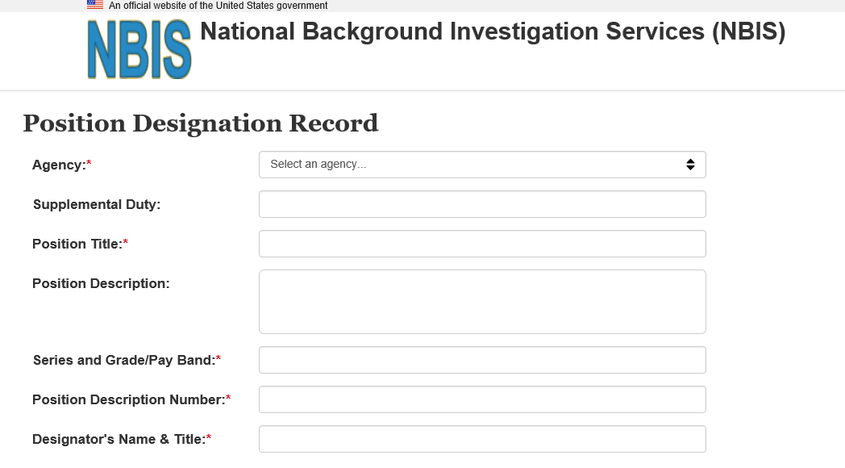
PDT Landing Page
OD
You can access the PDT by visiting: https://pdt.nbis.mil/
[select Department of Health and Human Services/NIH]
[enter supplemental duty here]
[enter position title here] Can be more specific than what is listed in NED
[optional: enter position description here]
[enter series and grade for FTE; enter “not applicable” for non-FTE]
[enter position description number for FTE; enter “not applicable” for non-FTE]
[enter individual who completed the PDT who DPSAC can contact with questions]
Fields are free text. Valid characters for all fields are: a-z, 0-9, spaces, and special characters: () " ' - _ . ,
ORS Office of the Director | ors.od.nih.gov
Notes:
Here we are going to go through the steps of completing the Position Designation Tool. First thing you want to have ready is your position description or equivalent (i.e. Statement of Work/position information). The process to complete the PDT could take anywhere from 2 minutes to a half an hour, depending on how familiar the designator is with the position and the various Public Trust and National Security selections available. The designator should read the entire position description and be very familiar with the position when completing the PDT. If not, they should rely on the supervisor, project officer, COR, etc. to gain more insight into the position. Again, developing a familiarity with the position description and various selections within the PDT tool that would correspond with the position responsibilities is critical.

Slide 14
Step 1. National Security Responsibilities
OD
Any national security duties will be selected by checking the appropriate box as outlined on the next slide.
Reminder:
For contractor positions, you assess the duties the position will be performing for the Federal Government and not for their contractor employer.
If you are not sure if any of the boxes are applicable, please contact the supervisor or project officer who will be overseeing the person filling the position.
ORS Office of the Director | ors.od.nih.gov

Slide 15
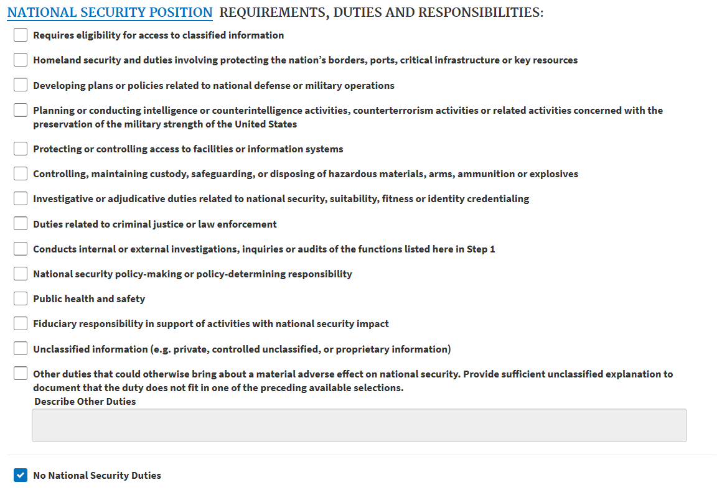
Step 1: Identify National Security Responsibilities
Select all National Security factors that apply
- OR -
Select no factors apply
ORS Office of the Director | ors.od.nih.gov
Notes:
First thing you will do after the introduction is identify and select the national security requirements of the position. For each of these possible selections, you should be thinking about the position as it relates to national security. If the individual has public health and safety requirements, but those responsibilities have no impact on the National Security of the United States, the national security selection should not be made. These factors are similar to the “Exception Factors” that are filled out during the NED registration process. However, those factors are NIH specific and are not all-inclusive.
Okay what is national security? National Security Position: Any position in a department or agency, the occupant of which could bring about, by virtue of the nature of the position, a material adverse effect on the national security.
As defined in 5 CFR 1400.102(a), national security “refers to those activities which are directly concerned with the foreign relations of the United States, or protection of the Nation from internal subversion, foreign aggression, or terrorism.”
If no national security requirements exist, simply check the box, “No national security duties”. If selections are made to this section, the designator will need to define the scope of impact for those selections on the next screen.

Slide 16
National Security Defined
National Security Position: Any position in a department or agency, the occupant of which could bring about, by virtue of the nature of the position, a material adverse effect on the national security.
As defined in 5 CFR 1400.102(a), national security “refers to those activities which are directly concerned with the foreign relations of the United States, or protection of the Nation from internal subversion, foreign aggression, or terrorism.”

Slide 17
Step 1a: Determine the Potential Damage to the National Security
OD
For any National Security factors selected, indicate the level of damage that may be caused by the position:
Please contact the supervisor or project officer who will be overseeing the person filling the position if unsure of which selections to make.
Select only one
ORS Office of the Director | ors.od.nih.gov

Slide 18
Step 2: Identify Public Trust Responsibilities
OD
Any public trust duties will be selected by checking the appropriate box as outlined on the next slide.
Reminder:
For contractor positions, you assess the duties the position will be performing for the Federal Government and not for their contractor employer.
If you are not sure if any of the boxes are applicable, please contact the supervisor or project officer who will be overseeing the person filling the position.
ORS Office of the Director | ors.od.nih.gov

Slide 19
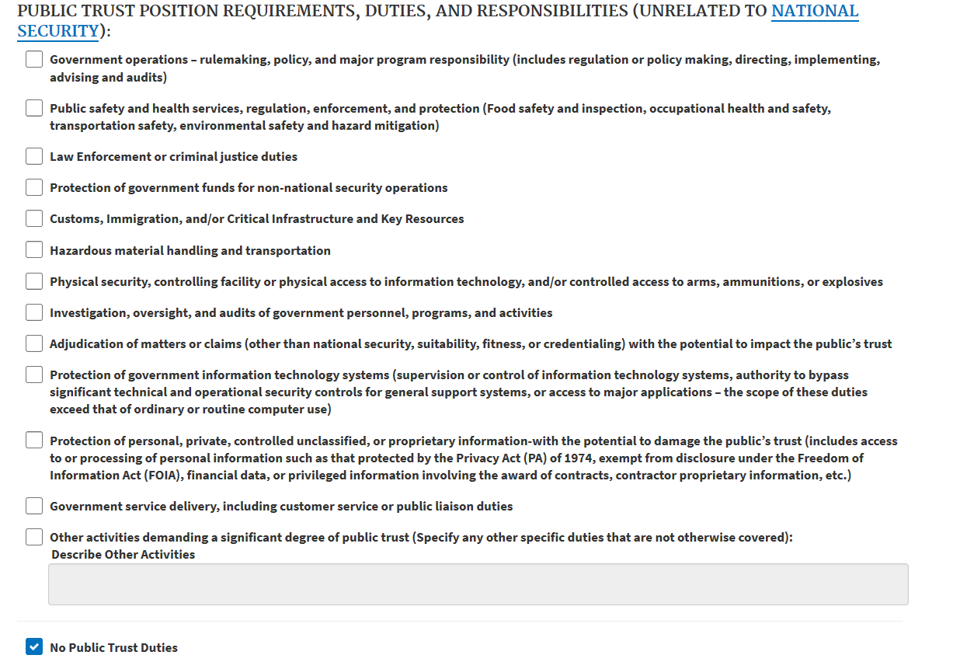
Step 2: Identify Public Trust Responsibilities
OD
Select all public trust factors that apply
- OR -
Select no factors apply
ORS Office of the Director | ors.od.nih.gov

Slide 20
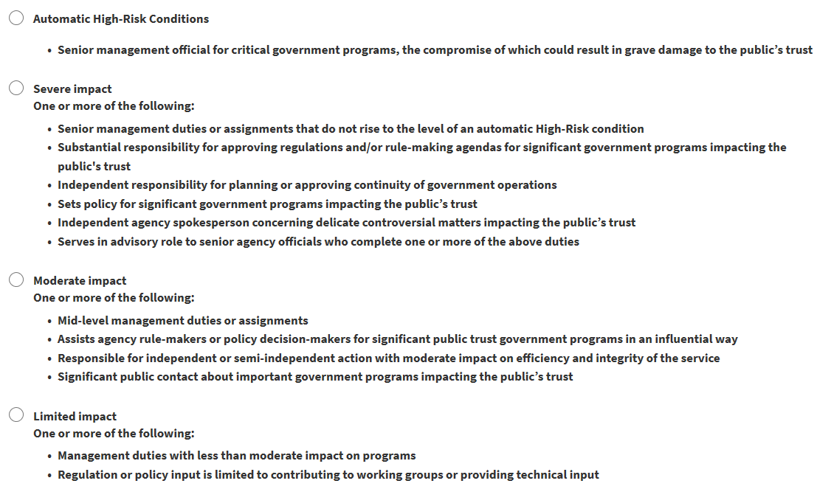
Step 2a: Determine the potential impact on the efficiency or integrity of the service
OD
For any Public Trust factors selected, indicate the level of damage that may be caused by the position:
Select only one
ORS Office of the Director | ors.od.nih.gov

Slide 21
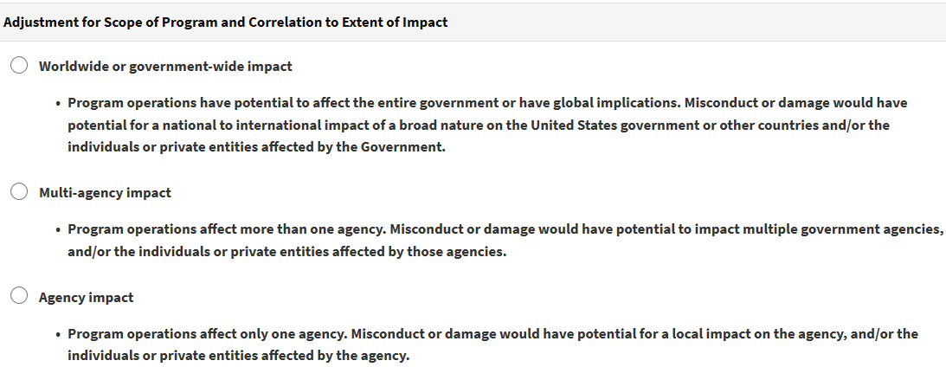
Step 3a: Point Adjustments for Scope of Impact for Damage
OD
Select the scope of impact for any damage that may be caused by the position
If you are not sure which selections are applicable, please contact the supervisor or project officer who will be overseeing position
Select only one
ORS Office of the Director | ors.od.nih.gov
Notes:
Okay so now we are on Step 3 – selecting the scope of impact and level of supervision. Here, we are determining whether the impact or potential damage would have a worldwide impact, multi-agency impact or just an agency impact. As you can imagine, these selections are important to consider and will affect the overall point calculation of sensitivity and risk designation of the position.

Slide 22
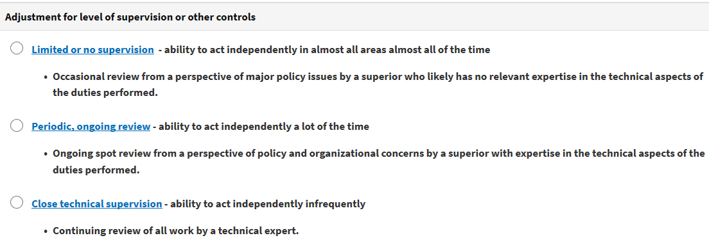
Step 3b: Point Adjustments for Level of Supervision
OD
For any factors that were selected in Section 2, indicate the level of supervision over the position
If you are not sure which selections are applicable, please contact the supervisor or project officer who will be overseeing position
Select only one
ORS Office of the Director | ors.od.nih.gov
Notes:
Now, we are making point adjustments for level of supervision. As you could imagine, an individual in a sensitive position that has little to no supervision could cause significantly more damage to the public trust/national security when compared to an individual who is constantly reporting to their supervisor and has little opportunity to act independently, or their access is restricted in a way that they are unable to act independently in their position. For example, a DPSAC employee who has access to NIH badging cardstock could have the potential to cause significant damage to the NIH should they decide to abuse their position to make a fake badge; however, there are many controls in place to prevent something like that from occurring to include the level of supervision on that individual.

Slide 23
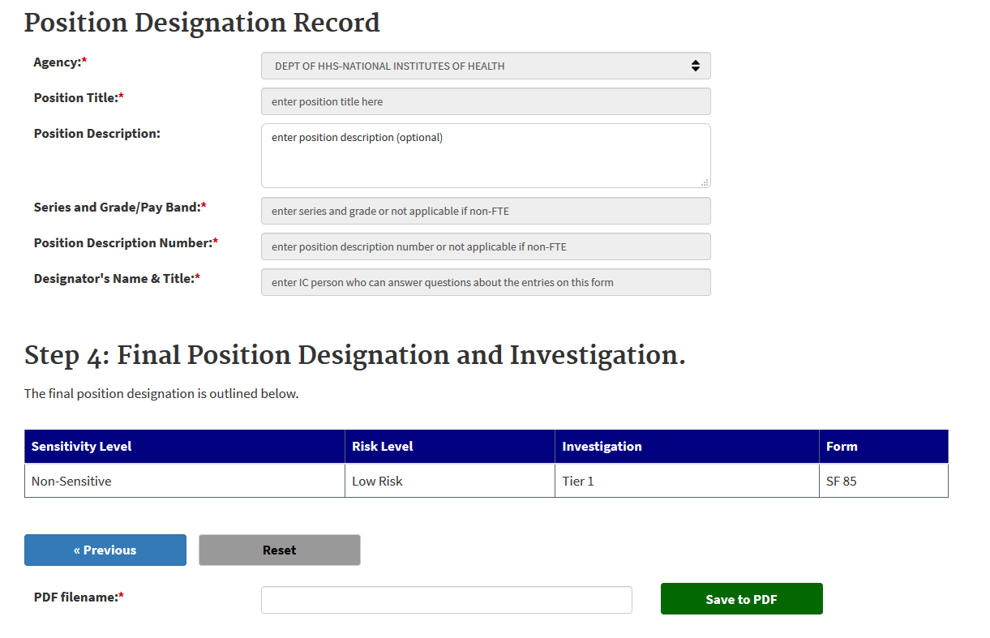
4. PDT Final Designation
OD
Once complete, you will see the final position designation record. You can then save a copy of the record as a PDF file for uploading to NED.
Use this to save the file for uploading to NED
ORS Office of the Director | ors.od.nih.gov

Slide 24
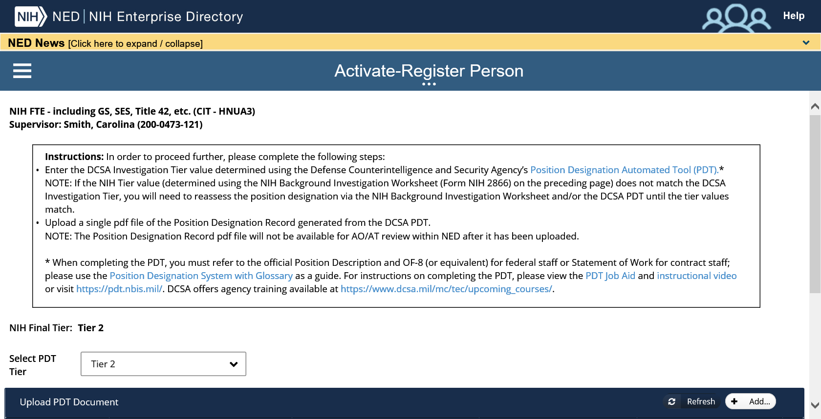
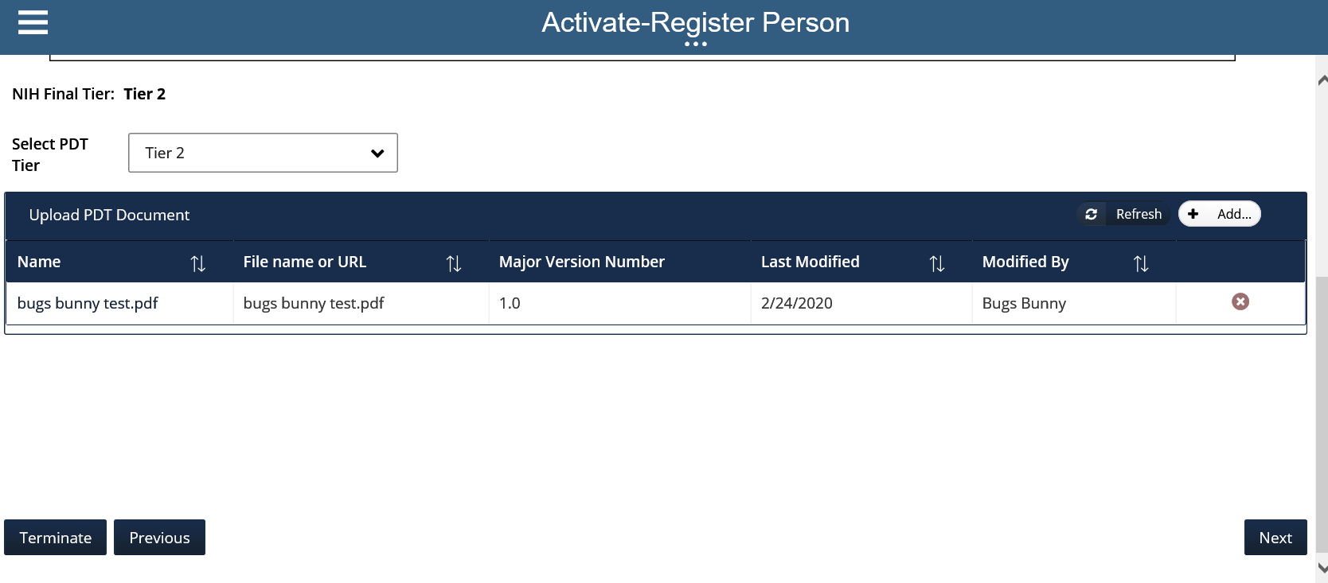
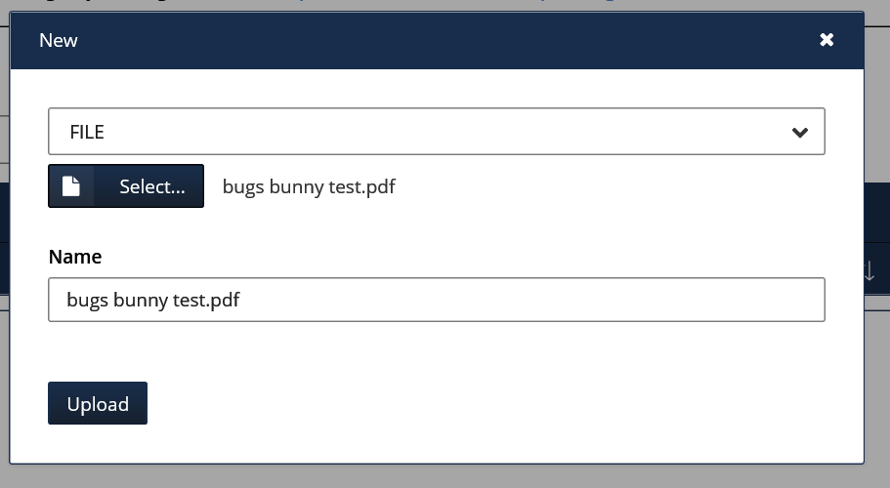
NED & PDT
Enter the PDT Tier Value into the NED system and upload the file:
Instructions
Select Tier Level
Upload PDT file

Slide 25
DPSAC Responsibility
Once the final Position Designation is made, DPSAC is responsible for:
Ensuring the correct investigation is conducted based on the individuals calculated Position Designation
Ensuring a suitability determination is made based on that investigation

Slide 26
Common Question
May the true PDT results be modified if the agency is not in agreement with the results?
For example, if a Division Director wants a Top Secret security clearance; however their final Position Designation is Tier 2 (non-sensitive moderate risk public trust)
NO
Notes:
May the PDT results be modified if the agency is not in agreement with the results? NO
Obviously, if the designator made a mistake, then the mistake should be corrected; however, if the position designation process was correctly followed, and all of the appropriate information was considered in completing the process, then the resulting designation and required level of investigation is final.

Slide 27
PDT Resources
OD
For generic questions on the PDT, please contact the ORS Division of Personnel Security & Access Control at 301-402-9755 or ORSPersonnelSecurity@mail.nih.gov.
If you have questions on how to properly designate a position, or would like assistance designating a position, please contact DCSA Suitability Adjudications at (724) 794-5612, extension 7400 or email SUITEA@opm.gov. DPSAC does not offer assistance completing the PDT.
DCSA Position Designation training is highly recommended. Please view https://www.dcsa.mil/mc/tec/upcoming_courses/ for a list of available courses.
To see a quick tutorial on the PDT, please visit: https://www.opm.gov/leaving/index.aspx?link=https://youtu.be/LCrT_C_OIwg
ORS Office of the Director | ors.od.nih.gov

Slide 28
Contact Information
For general inquiries on the referenced materials, please visit the DPSAC website at https://www.ors.od.nih.gov/ser/dpsac/resources/Pages/investigation-requirements-for-your-position.aspx
Contact:
DPSAC Helpdesk: 301-402-9755
Email: ORSPersonnelSecurity@mail.nih.gov

