Slide 1
Farhad Memarzadeh, Sheri Bernstein, Reza Jafari, Robert Henry, and Mike Shaw.
Farhad Memarzadeh, Sheri Bernstein, Reza Jafari, Robert Henry, and Mike Shaw.
Performance Management Presentation
Lease, Purchase and Dispose of Real Estate
Team Members:
Melissa Richardson, Veronica Crawford-Robinson, Robert England, Stewart Hill
Technical Advisor: Patrick Patterson, The Balanced Scorecard for Government
Technical Support: Joseph Wolski, OQM, ORS
9 January 2004
Notes:
This Table of Contents lays out a recommended structure for your PM presentation. Notice this page describes the Main Presentation. Keep in mind that you have approximately 30 minutes for the presentation, including questions from the audience. The means you will need to select one or two objectives per perspective from your Performance Management Plan (PMP), one or two measures for each objective selected, and the corresponding data and graphs for each of the measures selected. All the remaining objectives, measures, graphs, and interpretation for your PMP should be placed in the Appendix.

Slide 2
Mission
The Division of Real Property Acquisition Services (DRPAS) supports biomedical research by providing construction, real estate, and other contract support services. We commit to doing this in a cost effective, timely, quality, and flexible manner with maximum customer satisfaction.
Vision
The Division of Real Property Acquisition Services (DRPAS) will create a modernized, welcoming environment staffed with focused and competent personnel who are organized and recognized for timely, efficient, and effective services to our customers.

Slide 3
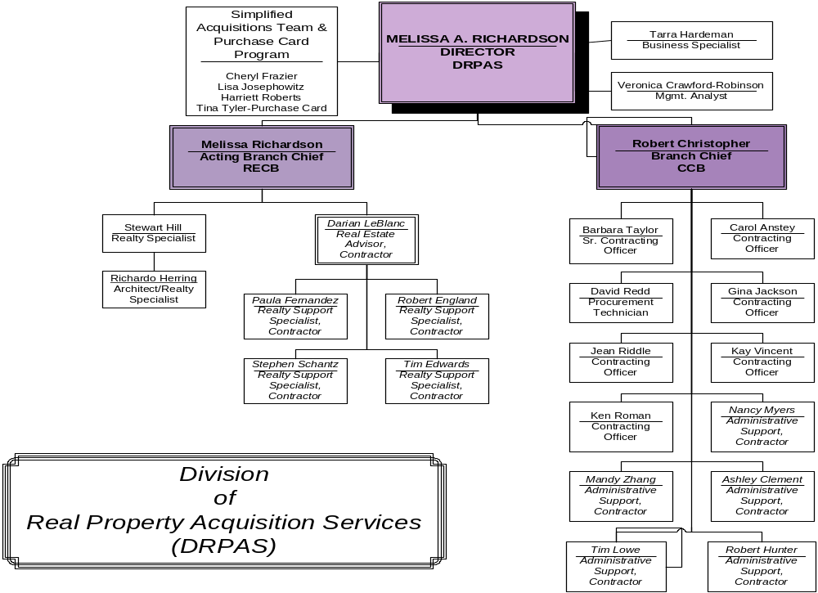
DPRAS Organizational Chart

Slide 4
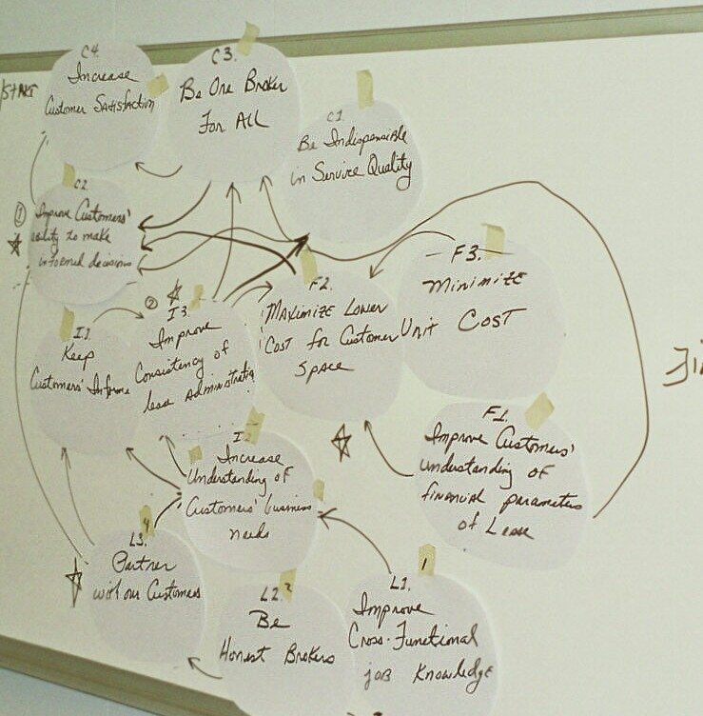
Top Goal
Strategy Mapping
Notes:
On this slide, discus the relationships among your performance objectives on your PMP. If you wish to use the strategy map diagram as a means to display these relationships, feel free to do so. Insert bullet statements summarizing your findings from your customer segmentation graphs, or insert the actual graphs if you desire.
If you want to insert a diagram here, you will need to add additional blank slides to your presentation, and import your graphics to that slide. To insert a slide, choose “Insert”, then “New Slide” from the menu, select the type of slide to insert, and then click “OK”.
Refer to page 4 of this presentation for directions on how to insert charts/diagrams/graphs from other programs into PowerPoint.

Slide 5
Strategy Mapping Conclusions and Actions
Strategy Mapping revealed that in order to achieve C1. Improve Customers’ Ability to make informed decisions and F1. Maximize the Lowest Cost for Space our team must IB1. Improve Consistency of Lease Administration and L1. Partner with our customers.
This analysis helped us focus our attention on ways to measure our progress in achieving these objectives.

Slide 6
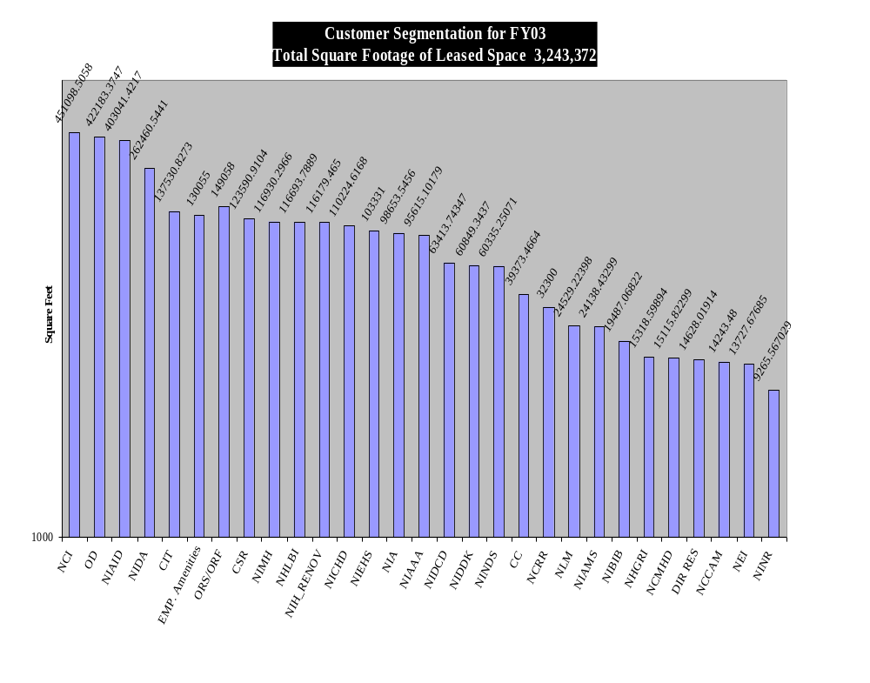

Slide 7
Critical Measures
Objective IB3. Improve consistency of lease administration
  Measure IB3.1. # Lease Files Fully Reviewed & Documented
Objective C2. Improve customers’ ability to make informed decisions
  C2.1 Average # of project change orders per lease action
Objective IB1. Keep Customers Informed
  IB1.2 # of SLA's processed for all Leases
Objective C1. Be indispensable in service quality
  C1.2 Total Financial Transactions processed (Invoices)
Objective F2. Maximize lower cost for customer space
  F2.1 Compare lease rates - local community and government comps

Slide 8
Lease Acquisition and Review
Internal Business Processes
Darian LeBlanc – Real Estate Consultant

Slide 9
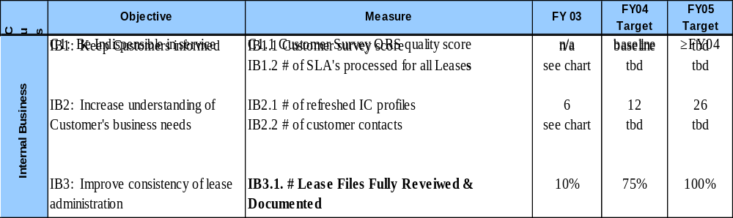
Internal Business Processes Perspective
Critical Measures
Notes:
Select which of the customer objective(s) are most important in the PMP, and use those objectives in the main part of the presentation. Place each objective you want to highlight on it’s own slide. This is an example of how the objective should be displayed. This example shows a customer perspective objective from the OQM template. Replace this objective with your own customer objective. Copy the appropriate row(s) from your PMP and insert it on this slide. Refer to page 4 of this presentation in the notes for directions on how to insert Excel charts into PowerPoint. Your PM consultant or OQM staff can also assist you if you have difficulty.

Slide 10
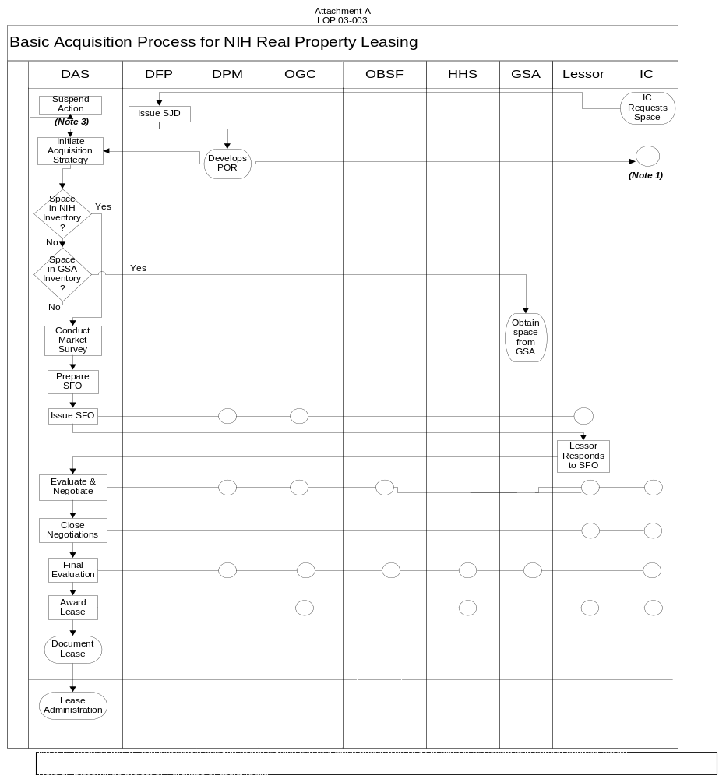
Lease Administration Deployment Flowchart

Slide 11
Lease Files Review and Results
Objective IB3. Improve consistency of lease administration
Measure IB3.1. # Lease Files Fully Reviewed & Documented
Lease Management Portfolio System Implemented FY 02
Reviewed 10% of Lease Portfolio consisting of old and new leases
Results indicate 93% reduction in errors in new vs. old

Slide 12
Lease Files Review and Results Continued
DRPAS Deployment Flowchart
Lease Acquisition and Management

Slide 13
Customer Perspective
Stephen Schantz – Real Estate Specialist

Slide 14
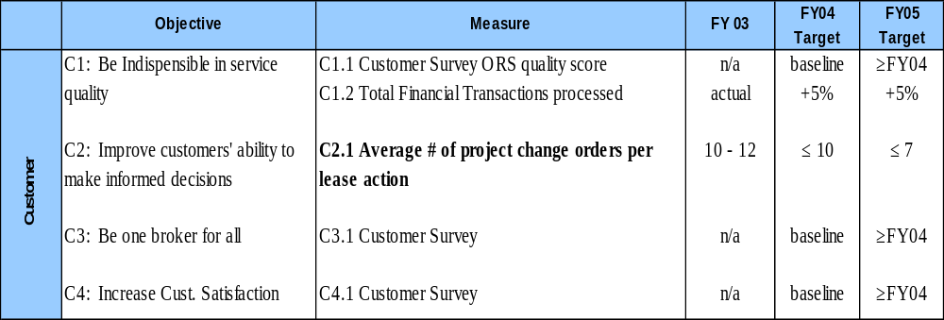
Customer Perspective
Critical Measures
Notes:
Transition Slide for the Customer Perspective.

Slide 15
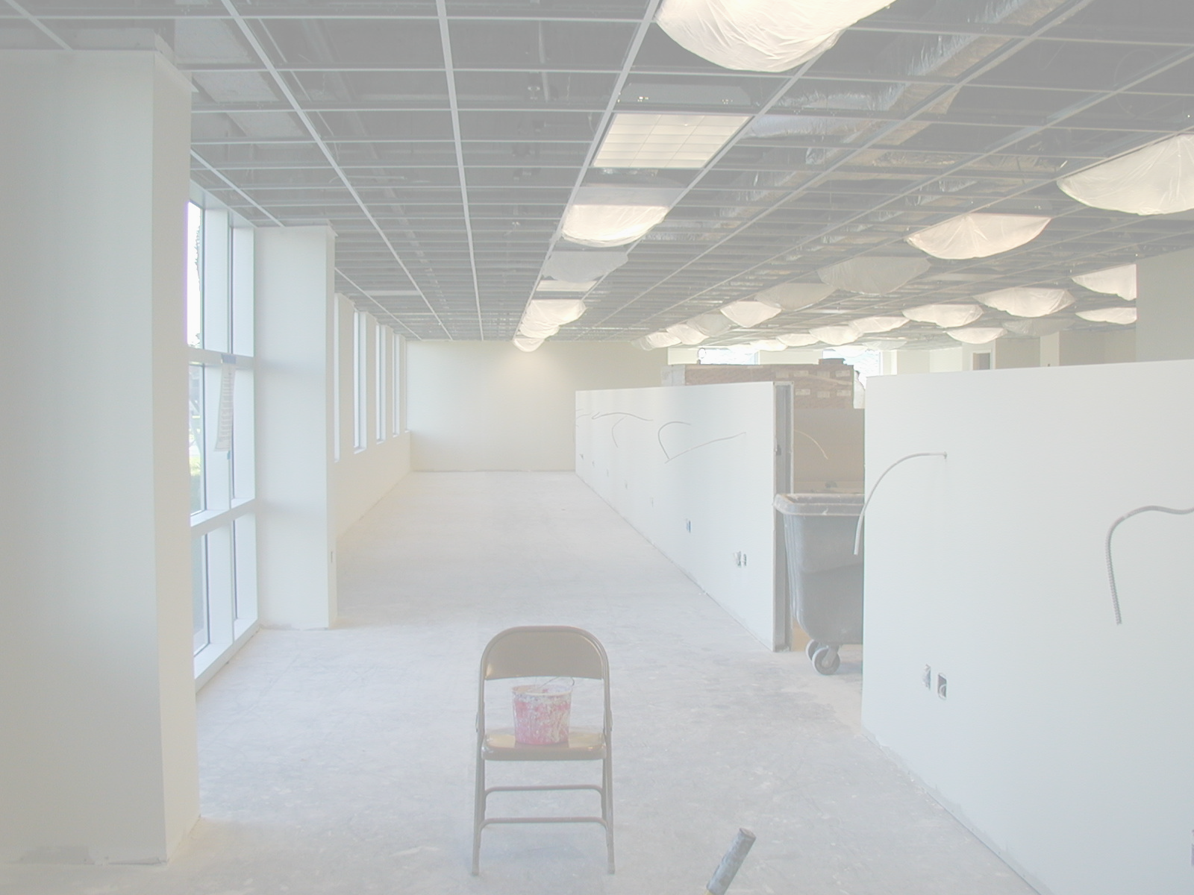
CONSTRUCTION CHANGE ORDERS
Notes:
Selling your ideas is challenging. First, you must get your listeners to agree with you in principle. Then, you must move them to action. Use the Dale Carnegie Training® Evidence – Action – Benefit formula, and you will deliver a motivational, action-oriented presentation.

Slide 16
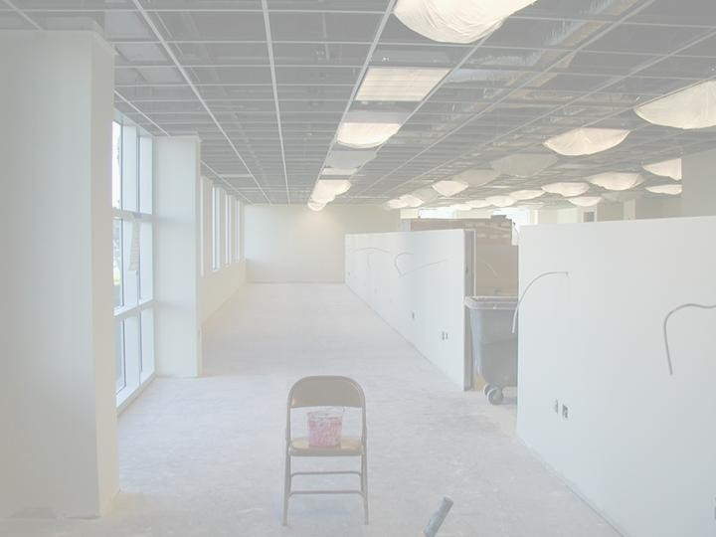
Points of Interests
On a $625,000 build-out of office space, an IC incurred $176,000.00 in construction Change Orders.
In most cases there’s a 12-15% increase to the original build-out cost.
On average, 10-12 Change Orders take place per project.
Excessive Change Orders will delay the completion of a project thereby extending move-in dates and ultimately increasing the overall cost of space delivery.
The most common reasons for Change Orders are
    Vague or ambiguous scopes of work.
    IC preferences, changes relative to upgrades and additions.
    Permit driven changes mandated by regulatory inspections.
    Unknown or unforeseen conditions
Notes:
Open your presentation with an attention-getting incident. Choose an incident your audience relates to. The incidence is the evidence that supports the action and proves the benefit. Beginning with a motivational incident prepares your audience for the action step that follows.

Slide 17
Recommendations
Clear, concise, thorough and more detailed scopes of work or proposals.
Better communication between all disciplines.
Better upfront coordination relative to requirements and upgrades/additions.
Continuing education for clients
    Brown Bag seminars
    Onsite presentations
    Web based information and tracking center
Notes:
Next, state the action step. Make your action step specific, clear and brief. Be sure you can visualize your audience taking the action. If you can’t, they can’t either. Be confident when you state the action step, and you will be more likely to motivate the audience to action.

Slide 18
Benefits
Immediate and long term savings on money allocated for current and future space requirements.
    Eliminating unnecessary Changer Orders reduce costs on average 10-12%
Shorter completion periods.
    Decreased cost associated with swing space or post completion rent payments.
    Smoother transition from old to new space.
Less stress
Notes:
To complete the Dale Carnegie Training® Evidence – Action – Benefit formula, follow the action step with the benefits to the audience. Consider their interests, needs, and preferences. Support the benefits with evidence; i.e., statistics, demonstrations, testimonials, incidents, analogies, and exhibits and you will build credibility.

Slide 19
Key Facts
Less ambiguous and more detailed scopes of work/construction proposals.
  Eliminates unnecessary Changer Orders
Better balance between requirements and upgrades/additions.
  Better value to NIH on money obligated for off campus expansion.
Better overall communication
Notes:
To close, restate the action step followed by the benefits. Speak with conviction and confidence, and you will sell your ideas.

Slide 20
Internal Business Processes
Robert England – Real Estate Specialist

Slide 21
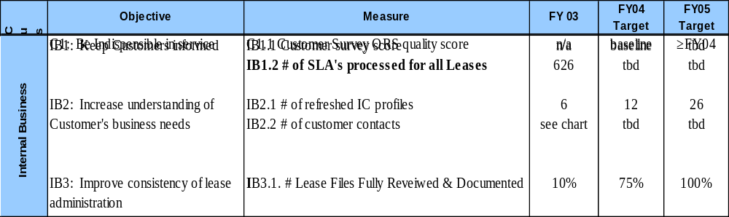
Internal Business Processes Perspective
Critical Measures
Notes:
Select which of the customer objective(s) are most important in the PMP, and use those objectives in the main part of the presentation. Place each objective you want to highlight on it’s own slide. This is an example of how the objective should be displayed. This example shows a customer perspective objective from the OQM template. Replace this objective with your own customer objective. Copy the appropriate row(s) from your PMP and insert it on this slide. Refer to page 4 of this presentation in the notes for directions on how to insert Excel charts into PowerPoint. Your PM consultant or OQM staff can also assist you if you have difficulty.

Slide 22
Point of Interest
Supplemental Lease Agreements are used to make changes or modifications to the lease.

Slide 23
Objective IB1. Keep the customers informed
Measure: IB1.2 Number of SLA’s processed on leases
FY 03
Number of SLA's Processed on 89 Leases
During FY 03
160
Total SLA's for FY 03 = 626
122
140
120
89
100
61
60
65
# of SLA's
80
69
60
16
19
21
53
27
40
23
20
0
OCT
NOV
DEC
JAN
FEB
MARCH
APRIL
MAY
JUNE
JULY
AUG
SEPT
Month

Slide 24
Financial Transactions – Invoices
Timothy Edwards
Notes:
Selling your ideas is challenging. First, you must get your listeners to agree with you in principle. Then, you must move them to action. Use the Dale Carnegie Training® Evidence – Action – Benefit formula, and you will deliver a motivational, action-oriented presentation.

Slide 25
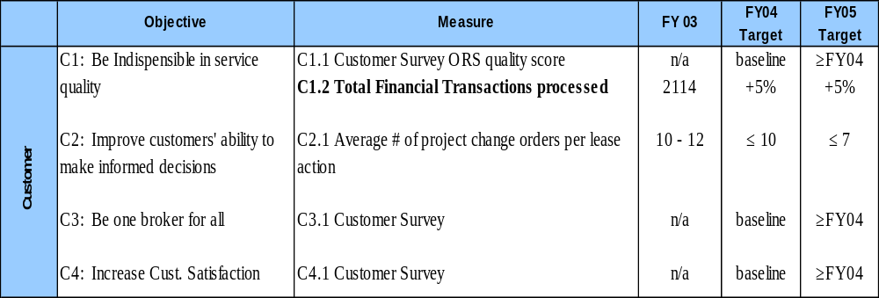
Customer Perspective
Critical Measures
Notes:
Transition Slide for the Customer Perspective.

Slide 26
Objective: C1. Be indispensable in service
Measure C1.2 Total financial transactions processed for customer leases FY 03
Number of Financial Transactions Processed in 2003
Total Financial Transactions =
2114
420
Utilities
626
Invoices,
Rent
& other
SLAs
1068

Slide 27
Facts
DRPAS has incorporated over 600 monthly, recurring invoices into Supplemental Lease Agreements (SLAs), thereby reducing the number of invoices processed per year.
Part of this reduction is a direct result of incorporating monthly, recurring invoices into SLAs, payable in the rent stream as additional rent.
Notes:
Open your presentation with an attention-getting incident. Choose an incident your audience relates to. The incidence is the evidence that supports the action and proves the benefit. Beginning with a motivational incident prepares your audience for the action step that follows.

Slide 28
Financial Perspective
Stewart Hill, Realty Specialist

Slide 29
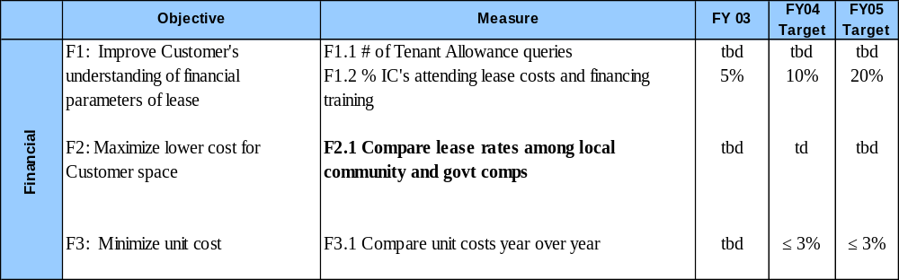
Financial Perspective
Critical Measures

Slide 30
Objective F2. Maximize lower cost for customers
F3.1 Compare lease rates
Currently comparing lease rates for administrative, research, storage and other special purpose use.
Comparing with other Federal Agencies and private sector.
NIH is the largest lease holder in Montgomery county – we are the market.
Consideration must be considered to prevailing market conditions at time of lease signing, delineated area, public accessibility and security.
Preliminary data suggests our newer leases are competitive

Slide 31
Conclusions and Key Initiatives
Conclusions
We are delivering competitive lease rates,
Our customers need more knowledge briefings on lease activities – the do’s and the don’ts
Our staff is capable of handling a wide range of lease administration activities
We need to continue collecting our process and financial measures on a regular basis and plan our business around the results
Key Initiatives
Implement Individual Development Plans for staff
Educate our customers by tagging along with the DFP meetings throughout the year
Integrate our leasing and contracting system to improve data reliability
Notes:
Transition Slide for your Conclusions.

Slide 32
The End

