Slide 1
Building 10 Emergency Evacuation Training September 9, 2015

Slide 2
Introduction

Slide 3
PURPOSE
The NIH must establish policies and procedures in order to implement and maintain an occupant evacuation plan designed to ensure that individuals and visitors located in all NIH owned or leased buildings are safely evacuated during an emergency.
This program is intended for NIH employees and staff in positions other than directly involved with patient care. The procedures for employees with direct responsibilities for patient care are outlined in the Joint Commission on Accreditation of Healthcare Organizations (JCAHO) requirements.
Important note: Employees, visitors and patients in the NIH Clinical Center and Clinical Research Center (CC/CRC) will follow the guidance of the Clinical Center Emergency Management Plan.

Slide 4
DIVISION OF EMERGENCY MANAGEMENT
The Division of Emergency Management (DEM) focuses on:
Employee Safety
Emergency Evacuation*
Emergency Preparedness
Emergency Recovery
Maintaining NIH Essential Functions
*The Building 10 Complex Emergency Evacuation Program is
part of the overall NIH Emergency Evacuation Program

Slide 5
NIH COOP PLAN
NIH has a Continuity of Operations (COOP) Plan in place that is designed to ensure continuity of the NIH mission essential functions while also maintaining the health and safety of the NIH employee, patient, and visitor community. It is an overarching strategy aimed at managing and recovering from situations or events that have a direct adverse impact on the operations of NIH.
The NIH COOP can be activated for any number of reasons:
An emergency effecting a single building such as a fire, flood, or collapse
An emergency effecting the local area such as a major chemical emergency or electrical outage
A regional crisis or a national emergency
In the event of a COOP activation that would require the closure of the NIH Bethesda campus, employees will be kept abreast of the situation through email, by phone, direct communication with supervisors, the NIH and IC Web pages, NIH radio 1660 am, local radio station, etc.

Slide 6
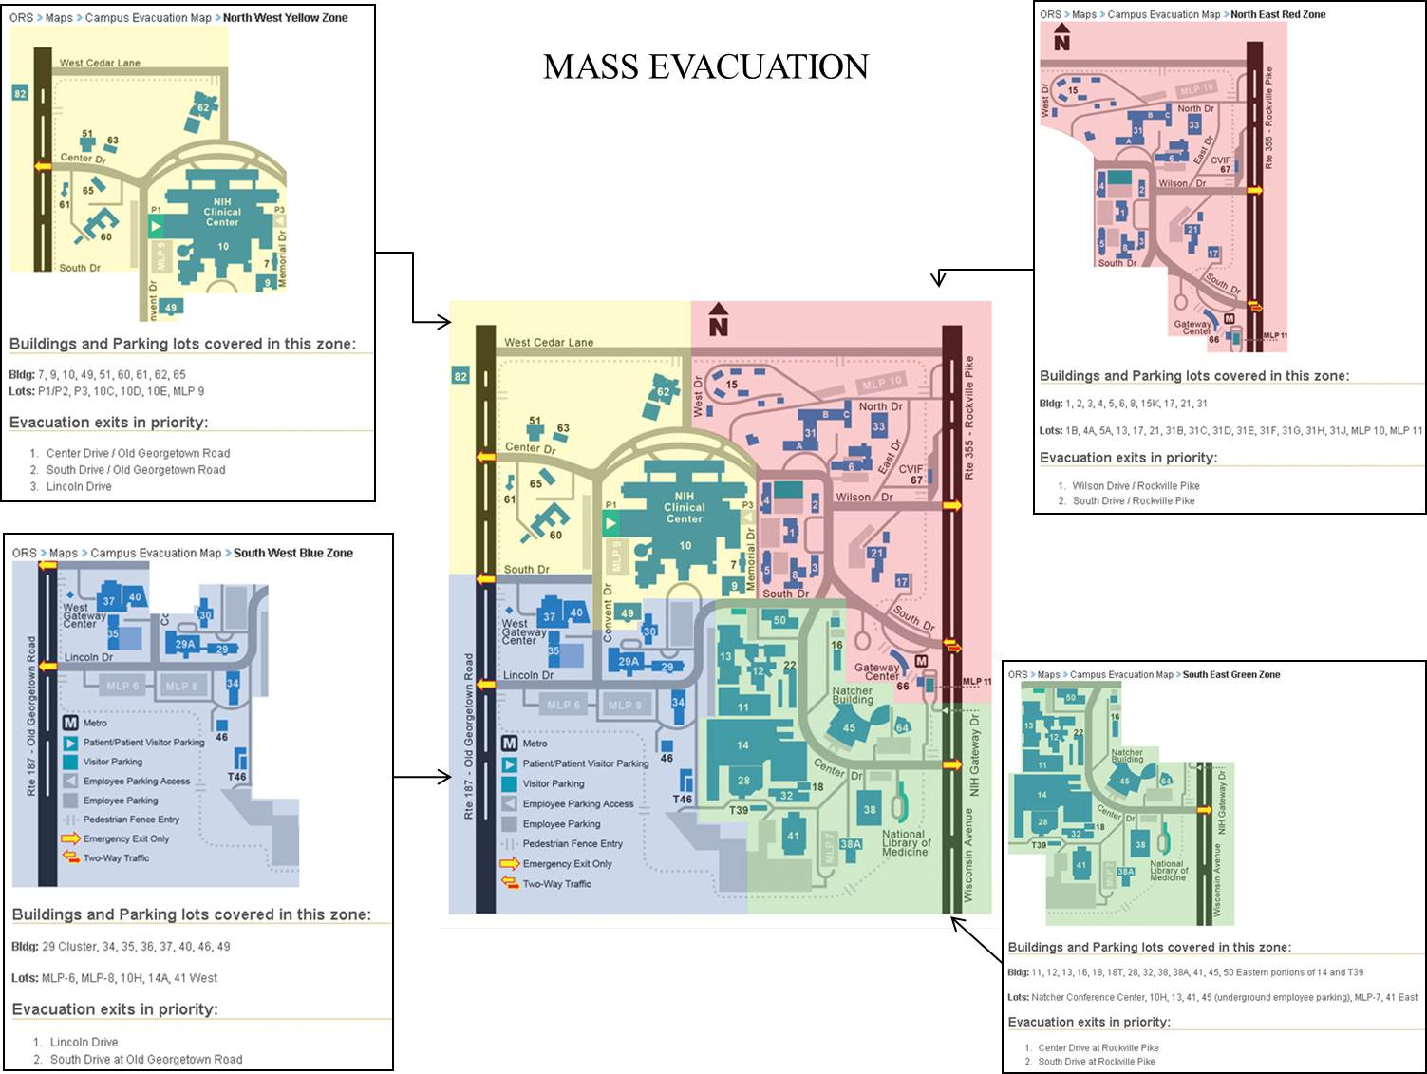
CAMPUS WIDE EVACUATION
The campus crisis plan organizes sections of the campus into emergency evacuation routes in the event of a crisis effecting a section of the campus or the entire campus.
Identify your route by finding your building location

Slide 7
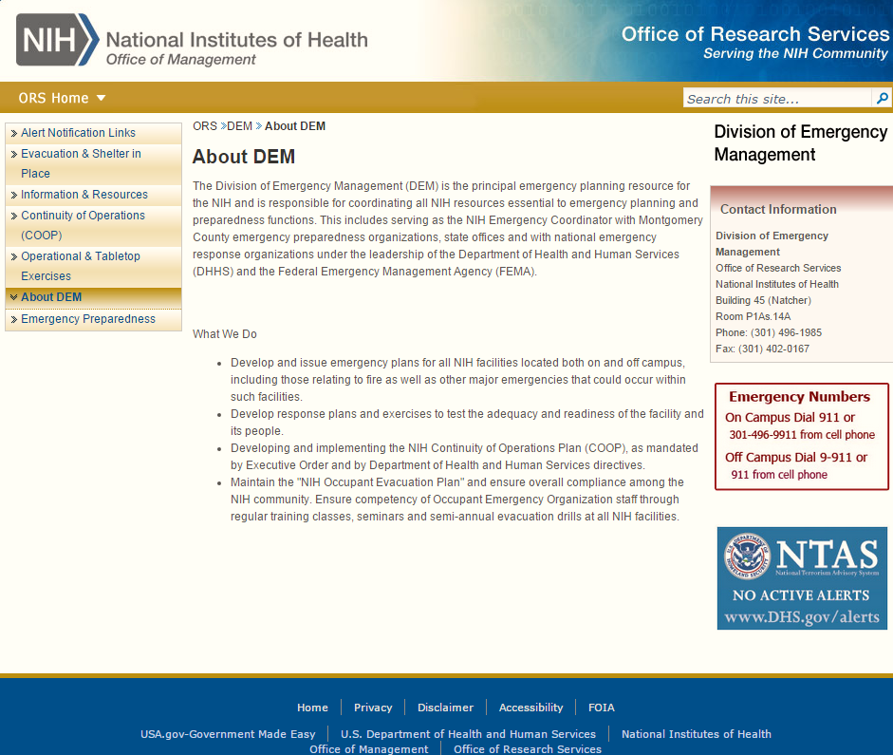
DEM WEBSITE
DEM Website. http://ser.ors.od.nih.gov/div_emergency_prep.htm

Slide 8
Awareness
Emergency Preparedness

Slide 9
Any and all emergencies must be addressed immediately
Personnel: Emergency situations with personnel, either hurt during the evacuation process, or a medical emergency, must be called into 911
Although the Emergency Response Personnel could already be on scene at the building, they may not be aware of other emergencies within the building, so call and report the situation
Before exiting a closed door during an alarm, feel for heat with the back of your hand, if it is warm or hot do not open, use an alternate exit
Emergency phone numbers:
On Campus Phone 911
Cell Phone On Campus 301-496-9911

Slide 10
SPECIAL NEEDS INDIVIDUALS
Special Needs Individuals evacuate to the pre-designated zone evacuation area (elevator lobby) with a buddy or co-worker
Emergency response personnel will ensure that the employee and their buddy are escorted to safety at any time they are in danger. However, if you are not in danger, you should remain at the pre-designated evacuation area
Special Needs Personnel are considered as any person who cannot safely evacuate an area in a swift manner under their own accord
Be observant for the not-so-obvious Special Needs Person

Slide 11
Safety and the Evacuation Process
DO NOT use elevators in case of emergency!
Report safety violations immediately to the Division of the Fire Marshal at 301-496-0487
Door knobs loose on emergency exits
Emergency exit lighting not illuminated
Boxes or equipment blocking hallways or life safety equipment

Slide 12
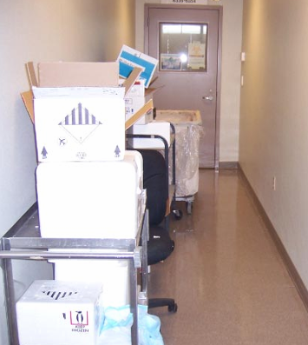
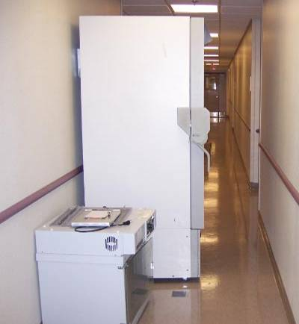
SAFETY ISSUES
No clear exit
Less than 54 inches of clearance
Clutter on one or both sides of hallway

Slide 13
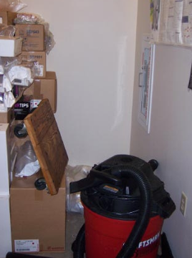
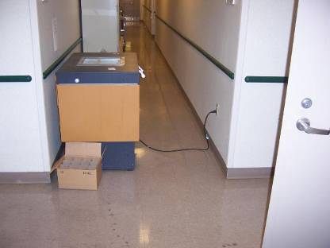
SAFETY ISSUES
Fire extinguisher blocked
Tripping hazard

Slide 14
EARTHQUAKE SAFETY INDOORS
Indoors
Drop to the floor
Take Cover by getting under a desk, table, or sturdy furniture
Hold On until the shaking stops
Stay Away from glass, windows, and anything that could fall
Secure all operations shut off gas/heat supply
Stay Inside until shaking stops and it is safe to go outside
Be aware that fire alarms may be sounding or sprinkler systems may be activated, but DO NOT activate the fire alarm system unless there is a fire, smoke, or uncontrolled gas leak.
DO NOT use the elevator during or after an earthquake!

Slide 15
EARTHQUAKE SAFETY OUTDOORS
Outdoors
Stay there
Move away from buildings, streetlights, trees, and utility wires
DO NOT enter buildings until they are inspected and determined to be safe for occupancy
Ground movement alone during an earthquake is seldom the direct cause of death or injury.
In a Vehicle
Stop a quickly as possible away from trees, utility wires, and overpasses
Once the earthquake has stopped, proceed with caution and avoid roads, bridges, or ramps that may have been damaged

Slide 16
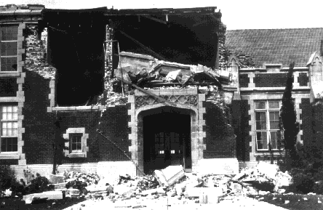
EARTHQUAKE SAFETY OUTDOORS
Evacuate the building checking for hazards and any injured people along the way
Move quickly away from the building to avoid falling objects.
If it is too dangerous to evacuate or if you
can not safely evacuate the building, get
to a safe location interior to the building
and call 911 to report your status and
location.

Slide 17
BOMB THREAT
Stay on the line with the caller, Write everything down, DO NOT hang up
Alert a co-worker and have them call 911 to report the possible bomb threat
DO NOT place the caller on hold; get as much information as possible
Be calm and polite
After the call is disconnected by the caller, immediately hang up the phone, pick up the phone and when you get a dial tone, press *57 (This flags the phone call for quick recognition by the phone company or investigators). Use another phone to call 911.
Pass all information to the Police Department upon their arrival
DO NOT activate the fire alarm as this may trigger the bomb
Verbally notify personnel if necessary to evacuate the area. Police should be on scene quickly, and will advise how to evacuate
Remember to keep calm and do not panic personnel

Slide 18
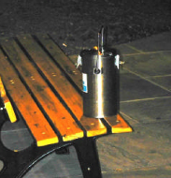
SUSPICIOUS PACKAGE
If you see a suspicious package:
Leave the room where the item is located
DO NOT touch suspected explosives
DO NOT use radio or cellular phone near suspected explosives
DO NOT activate the fire alarm
Immediately contact the Police:
On campus: 911 (office) or 301-496-9911 (cell phone)
Off campus: 9-911 (office) or 911 (cell phone)

Slide 19
LOCKDOWN
Lockdown is used when it is safer to stay in an area that can be secured than to move through the building where the potential threat may be encountered. A dangerous person could be someone with a legitimate purpose on site (employee, authorized visitor, contractor) or an unauthorized visitor.
Procedures for Lockdown:
Lock or barricade doors or opening and windows and pull shades immediately
Contact 911 immediately
Keep employees away from the doors and windows
Maintain a calm environment
If gunshot is heard, immediately have everyone lie down on the floor
Remain in the secured work area until notified to evacuate unless there is a greater risk to your safety to remain in the current location

Slide 20
SHELTER-IN-PLACE
Sheltering-in-place (SIP) will be used when it is safer for employees to remain inside the building rather than to evacuate. Interior windowless rooms can be used for SIP. Examples of SIP situations: tornado warnings and HAZMAT incidents.
Procedure:
Remain Calm
Immediately cease all operations . Confine any hazardous materials, open flames and oxygen.
Shut all doors behind you.
Proceed to the designated SIP area or to a safe windowless room.
Assist Special Needs Personnel, visitors or co-workers needing assistance.
Listen to the public address system for situation updates
DO NOT leave the building or SIP until authorities give the “all clear” signal

Slide 21
FIRE ALARM
Zoned Fire Alarm Systems & Evacuation

Slide 22
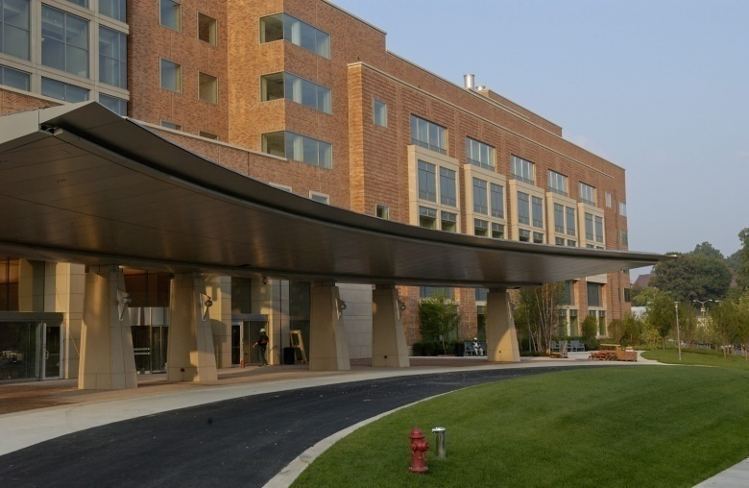
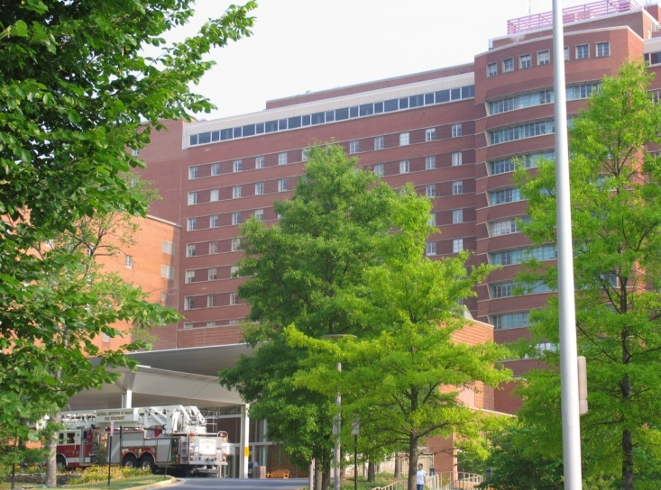
CLINICAL CENTER MAIN ENTRANCES
North Entrance
South Entrance

Slide 23
INITIATING FIRE ALARM DEVICES
There are three devices in the Building 10 Complex that can initiate a fire alarm
Manual Pull Station
Automatic Smoke Detector
Automatic Sprinkler System

Slide 24
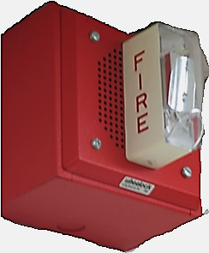
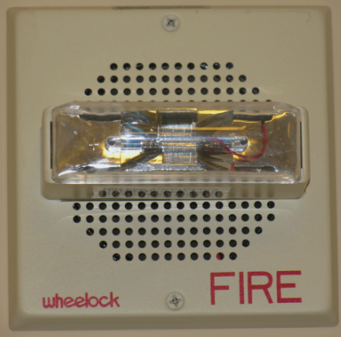
FIRE ALARM SYSTEM NOTIFICATION DEVICES
Strobe Light
Audible Voice Tape Message
Audible Whooping Sound (Horn)
Audible Chime Sound (Horn) – Patient Care Areas

Slide 25
TYPE OF FIRE ALARM SYSTEM
Zone Evacuation System
Fire Command

Slide 26
OVERVIEW OF THE BUILDING 10 COMPLEX

Slide 27
EVACUATION TEAMS – 3RD FLOOR & ABOVE

Slide 28
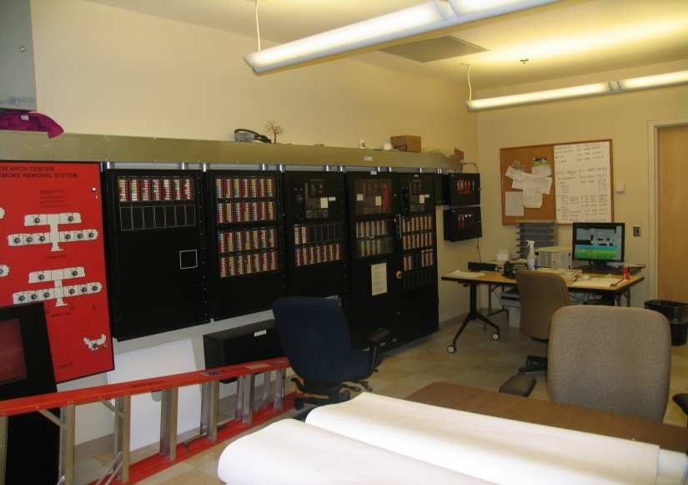
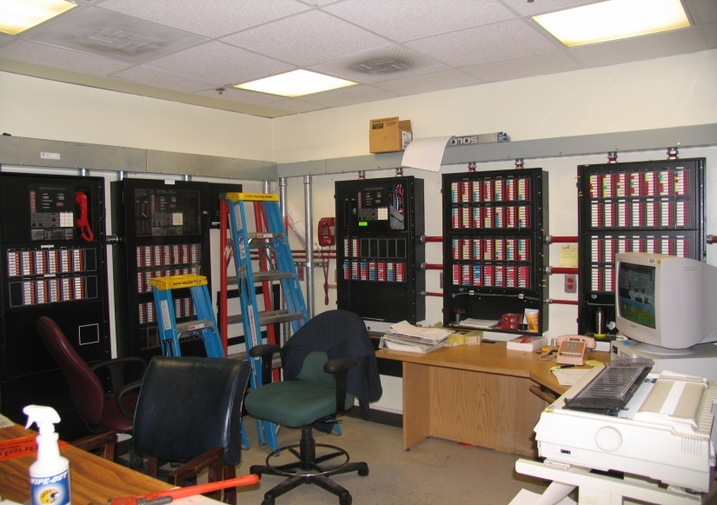
FIRE CONTROL ROOMS
Main Fire Alarm System
Control Room
Back Up Fire Alarm System
Control Room

Slide 29
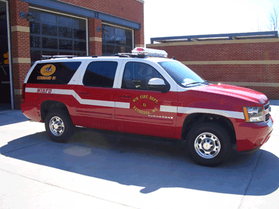
The Fire Department Office-In-Charge maintains control of the incident until the emergency has ended and it is safe to return to the area in question

Slide 30
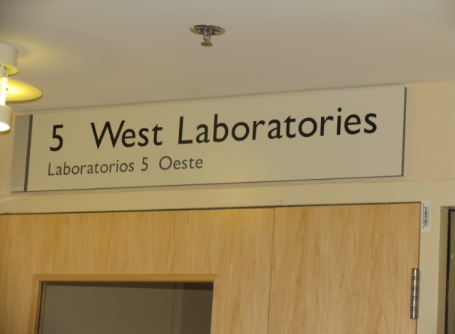
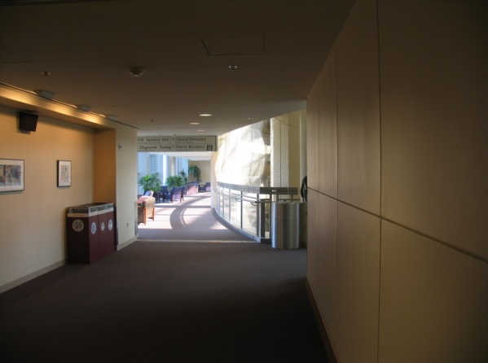
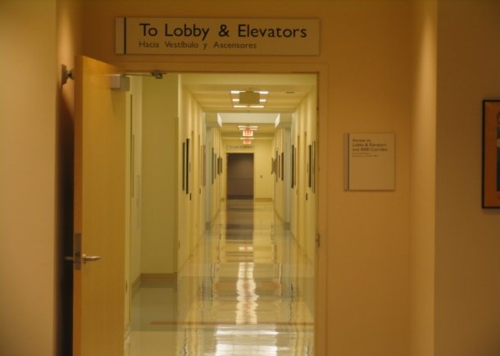
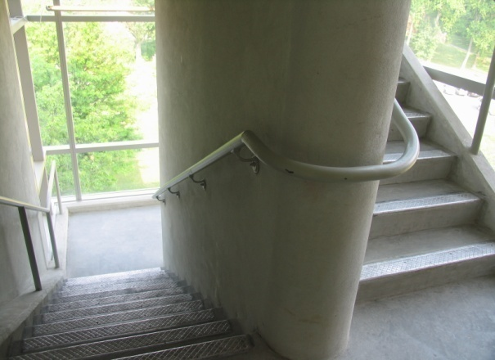
CRC BUILDING ZONE EVACUATION EXAMPLE
Primary Safe Area
Secondary Safe Area

Slide 31
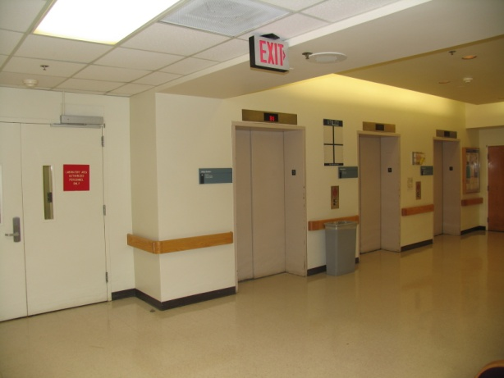
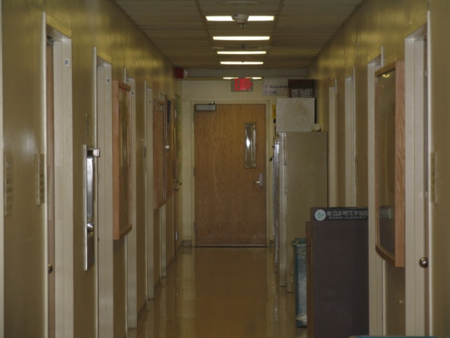
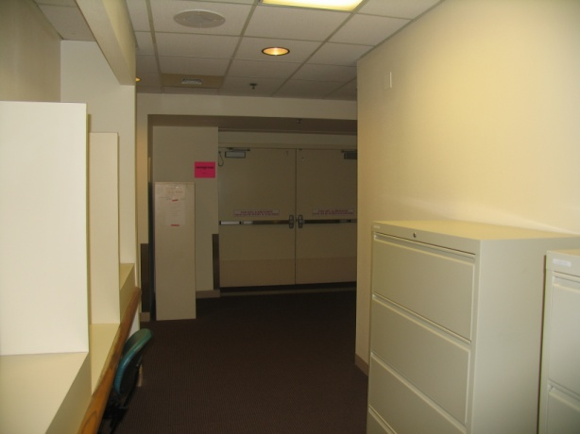
ACRF BUILDING ZONE EVACUATION EXAMPLE
Primary Safe Area
Secondary Safe Area

Slide 32
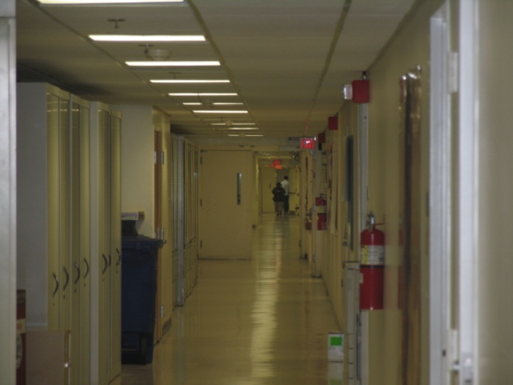
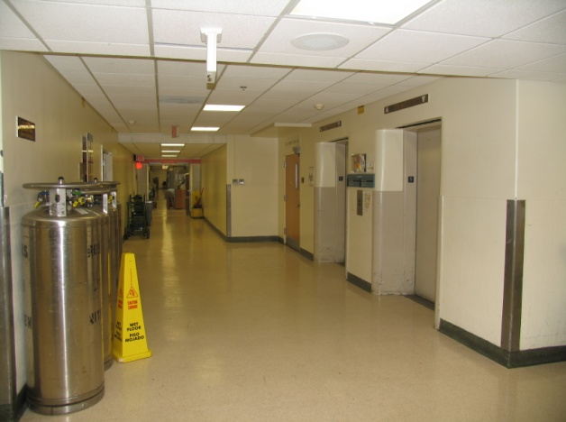
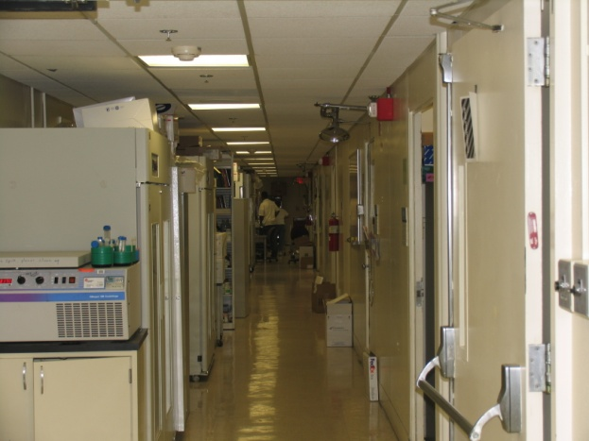
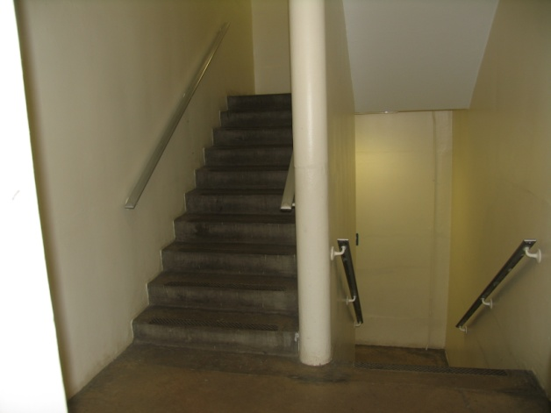
BUILDING 10 ZONE EVACUATION EXAMPLE
Primary Safe Area
Secondary Safe Area

Slide 33
Criteria: Resourceful individual who can demonstrate leadership ability in a crisis situation. Must spend a majority of time each business day in the area
Responsible for developing a good organization of team members within their Fire Zone
Coordinates and manages the overall evacuation or sheltering of personnel in the Fire Zone
Coordinates with Point of Contact (POC) from other ICs within the Fire Zone
Designates, prior to an emergency, the location within the primary and secondary safe areas for team members to meet
Relays evacuation/shelter information as necessary to Firefighters
Notifies and updates their co-workers during and/or after the emergency
Provides information and assistance to Special Needs Employees as necessary
Ensures that all areas in the fire zone are vacated and doors are closed during an evacuation

Slide 34
CONCLUSION
Additional questions can be directed to the following:
Division of Emergency Management
301-496-1985

