Slide 1
Biological Safety Cabinet (BSC) Cleaning: Below the Deck
NIH Division of Occupational Health and safety
(Individuals performing this procedure must have documented completion of NIH Laboratory safety training)

Slide 2
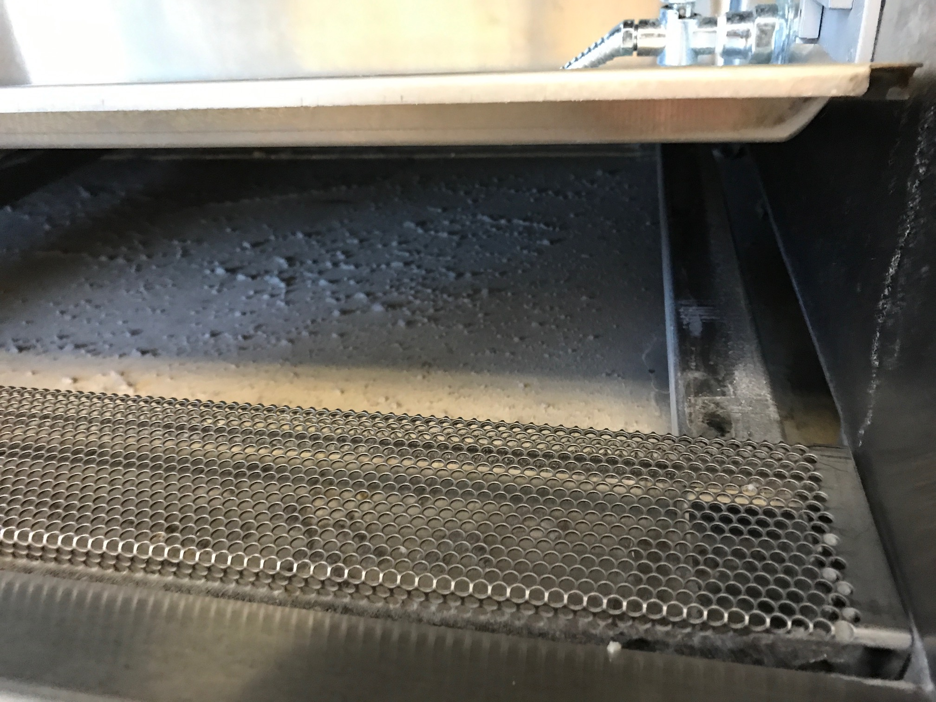
BSC Appearances
Outer appearances don’t
always indicate what’s inside
Notes:
Judicious research often have impeccable cleaning practices and keep their BSCs extremely clean to avoid contamination.
However, we often forget that lurking below the surface is a collection of dust, dirt, allergens, biological materials, chemicals and contaminants.
This presentation is dedicated to ensuring optimal BSC hygiene and preventing cellular contamination. It will also elongate the life of you BSC and guarantee ideal BSC motor functionality.

Slide 3
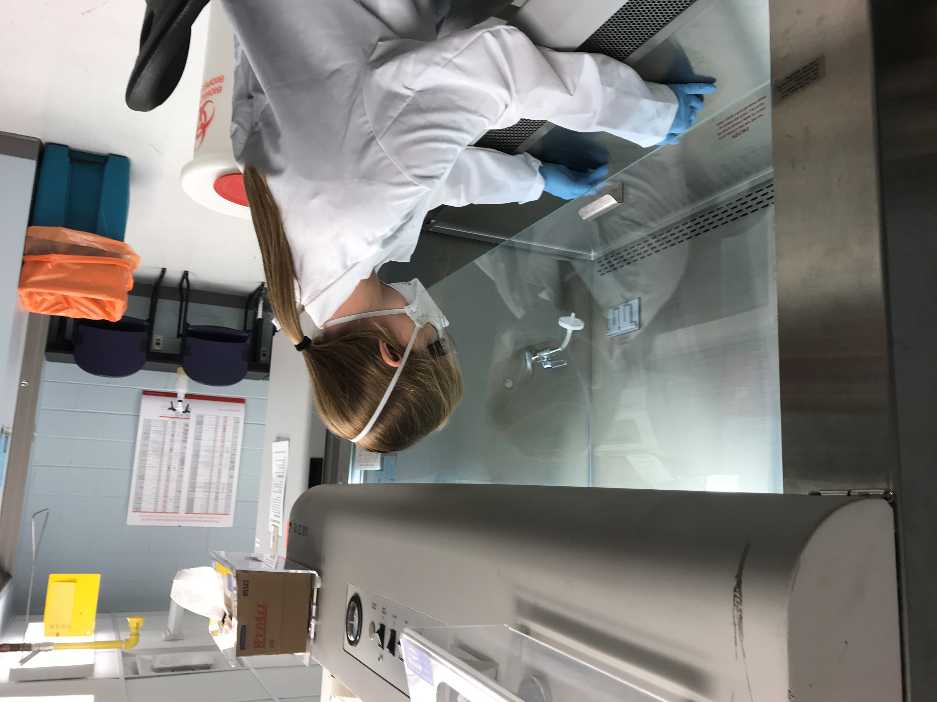
Proper Personal Protective Equipment
Don Proper PPE
While performing these manipulations, please wear:
Lab coat
Eye protection
Gloves appropriate to disinfectant (nitrile)
N95 (if required based on work performed in BSC)
Notes:
Before we begin, lets always attempt to don appropriate task appropriate PPE. In a case such as this, the user is going to be opening the inner compartments of the BSC, exposing themselves/others to dust, dirt, allergens, and potentially non-neutralized biological material. For this reason, we always recommend the appropriate PPE commensurate with the type of work being performed in the BSC.

Slide 4
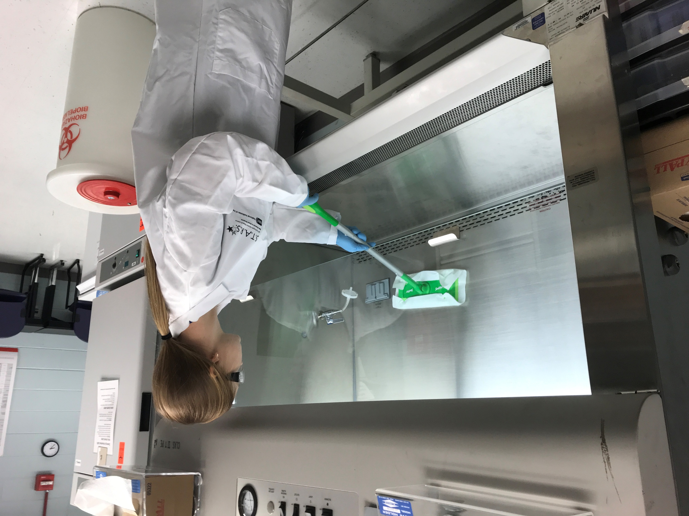
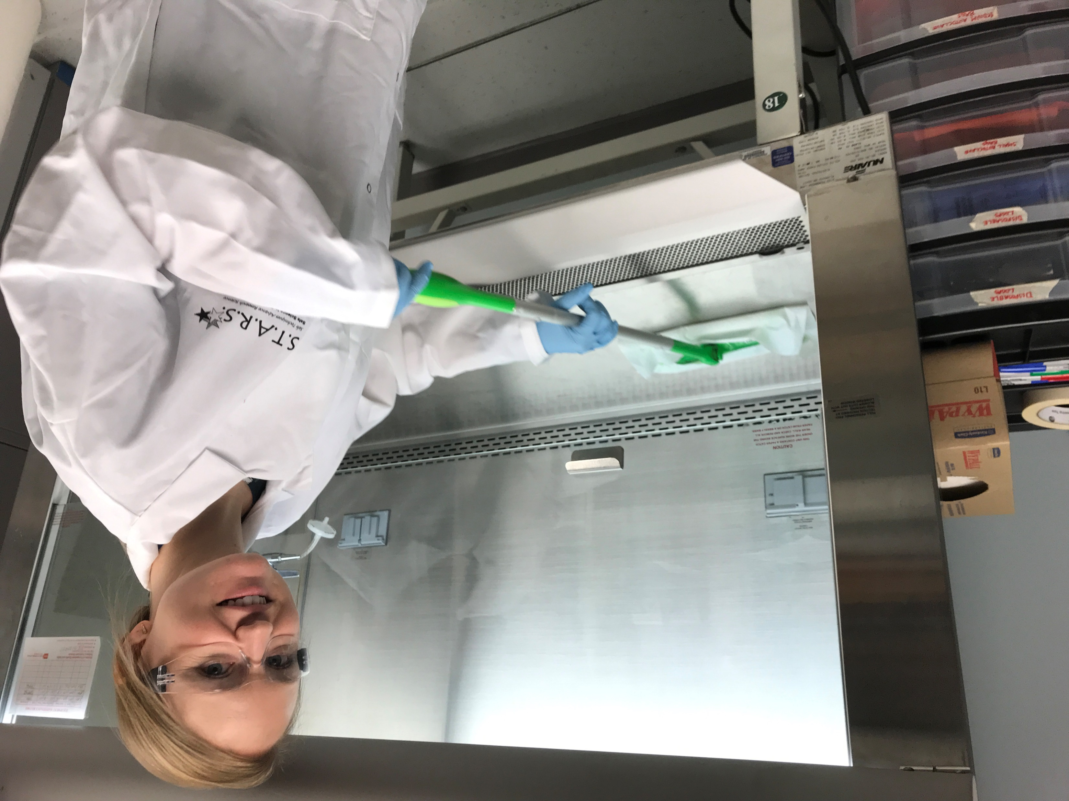
Initial Cleaning
Initial Cleaning
Wipe down entire hood with 1:10 Bleach or appropriate disinfectant (~10 minutes). We recommend using a disposable moping product as pictured here, lined with a paper towel.
Allow the surface to dry
Follow up with wiping entire surface down with 70% Ethanol
Notes:
In this slide we are really attempting to articulate two things:
ATTEMPT TO AVOID STICKING YOUR ENTIRE BODY IN THE HOOD AT ALL COSTS.
For every step here we are going to follow the same formula.
First disinfect with bleach
Then safe guard our equipment with Etoh.

Slide 5
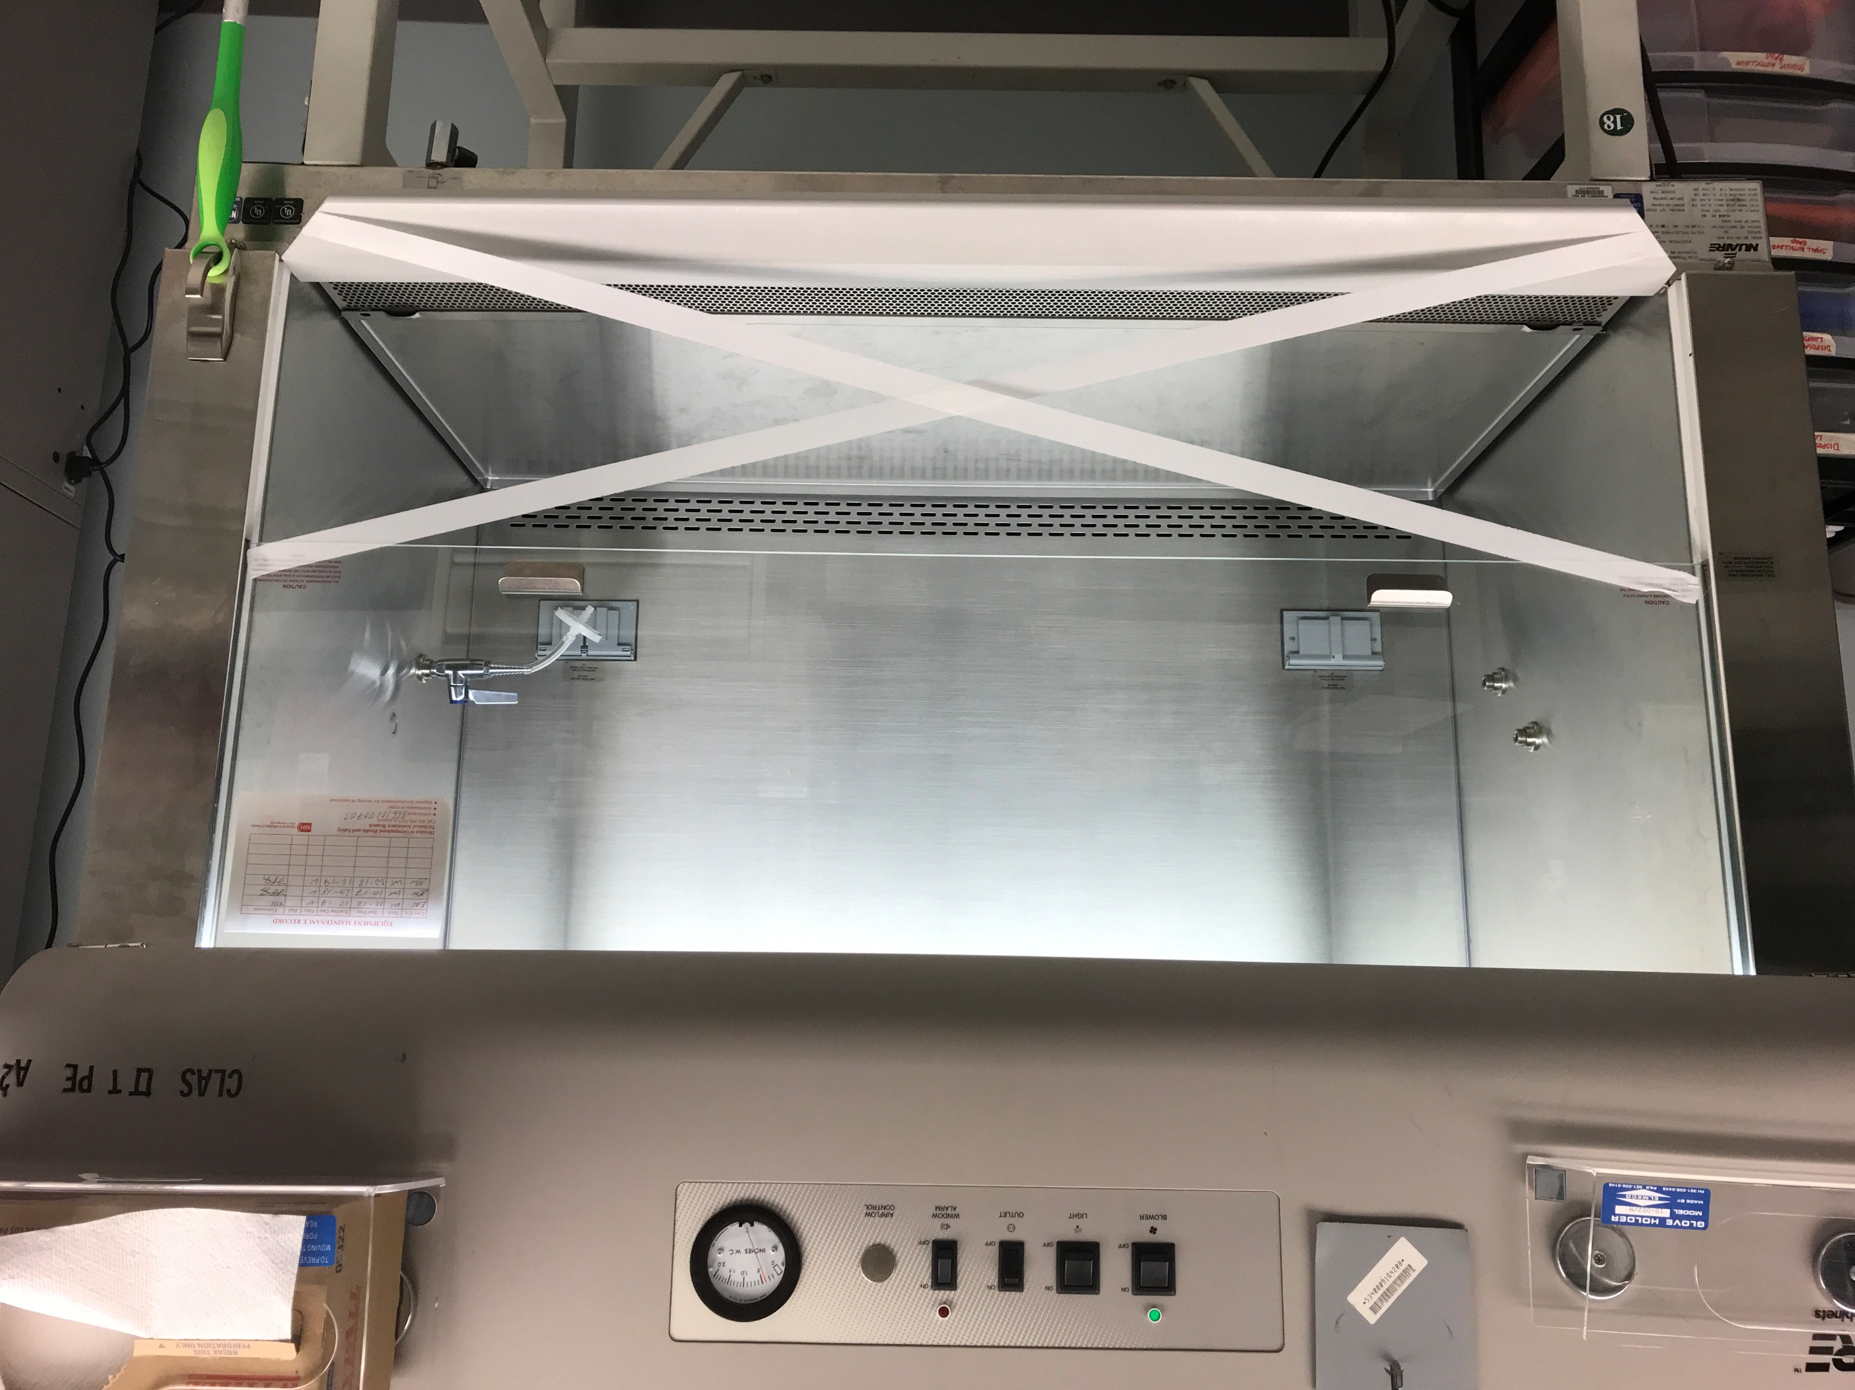
BSC Airflow
Run Airflow Continuously
Turn on air flow in the hood and run continuously for 48 hours (weekend) (This helps desiccate biological material contained within the unit)
As a precaution, tape the opening of the hood to prevent it from being used
Place a sign informing that the BSC will be out of service until the decontamination process is completed

Slide 6
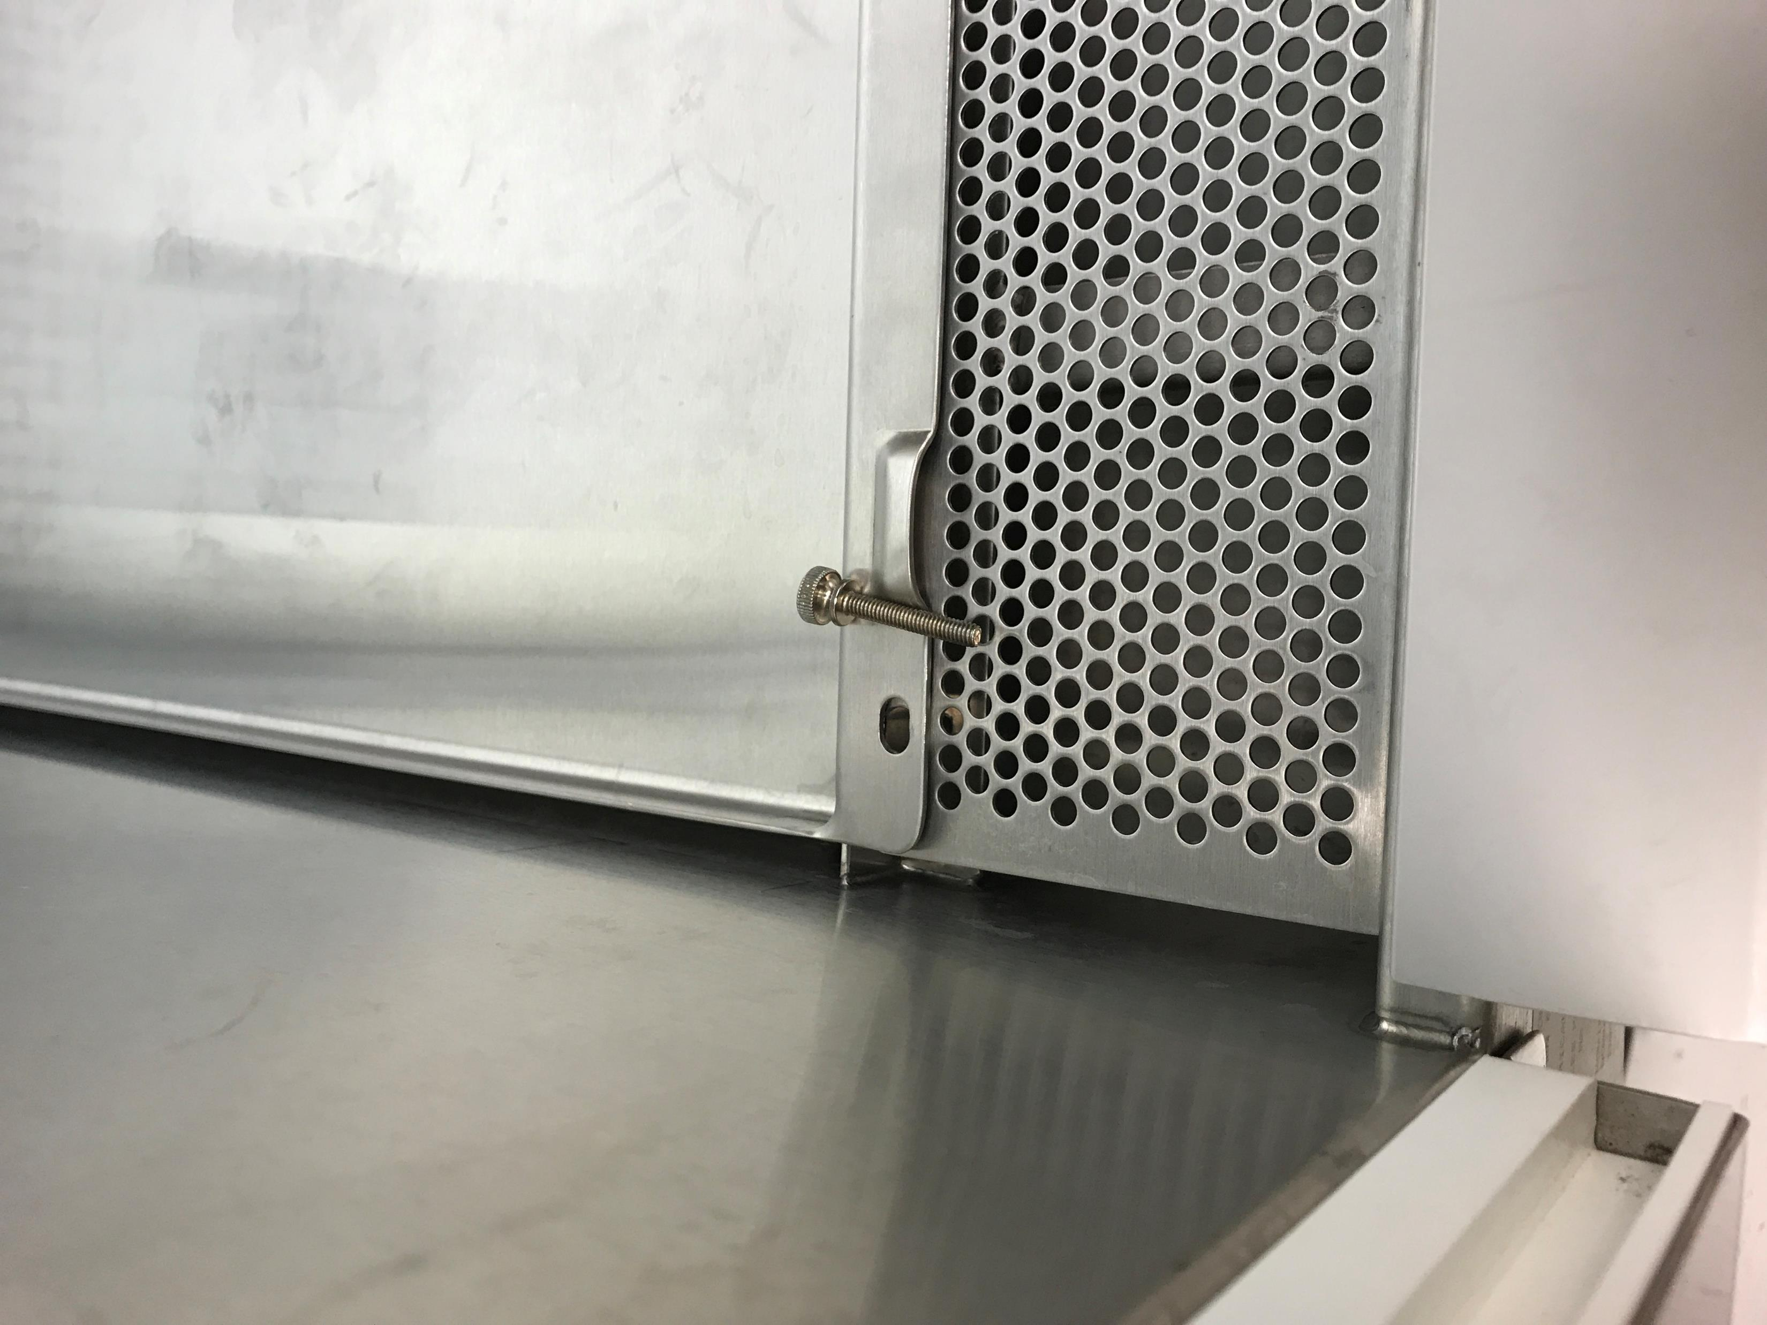
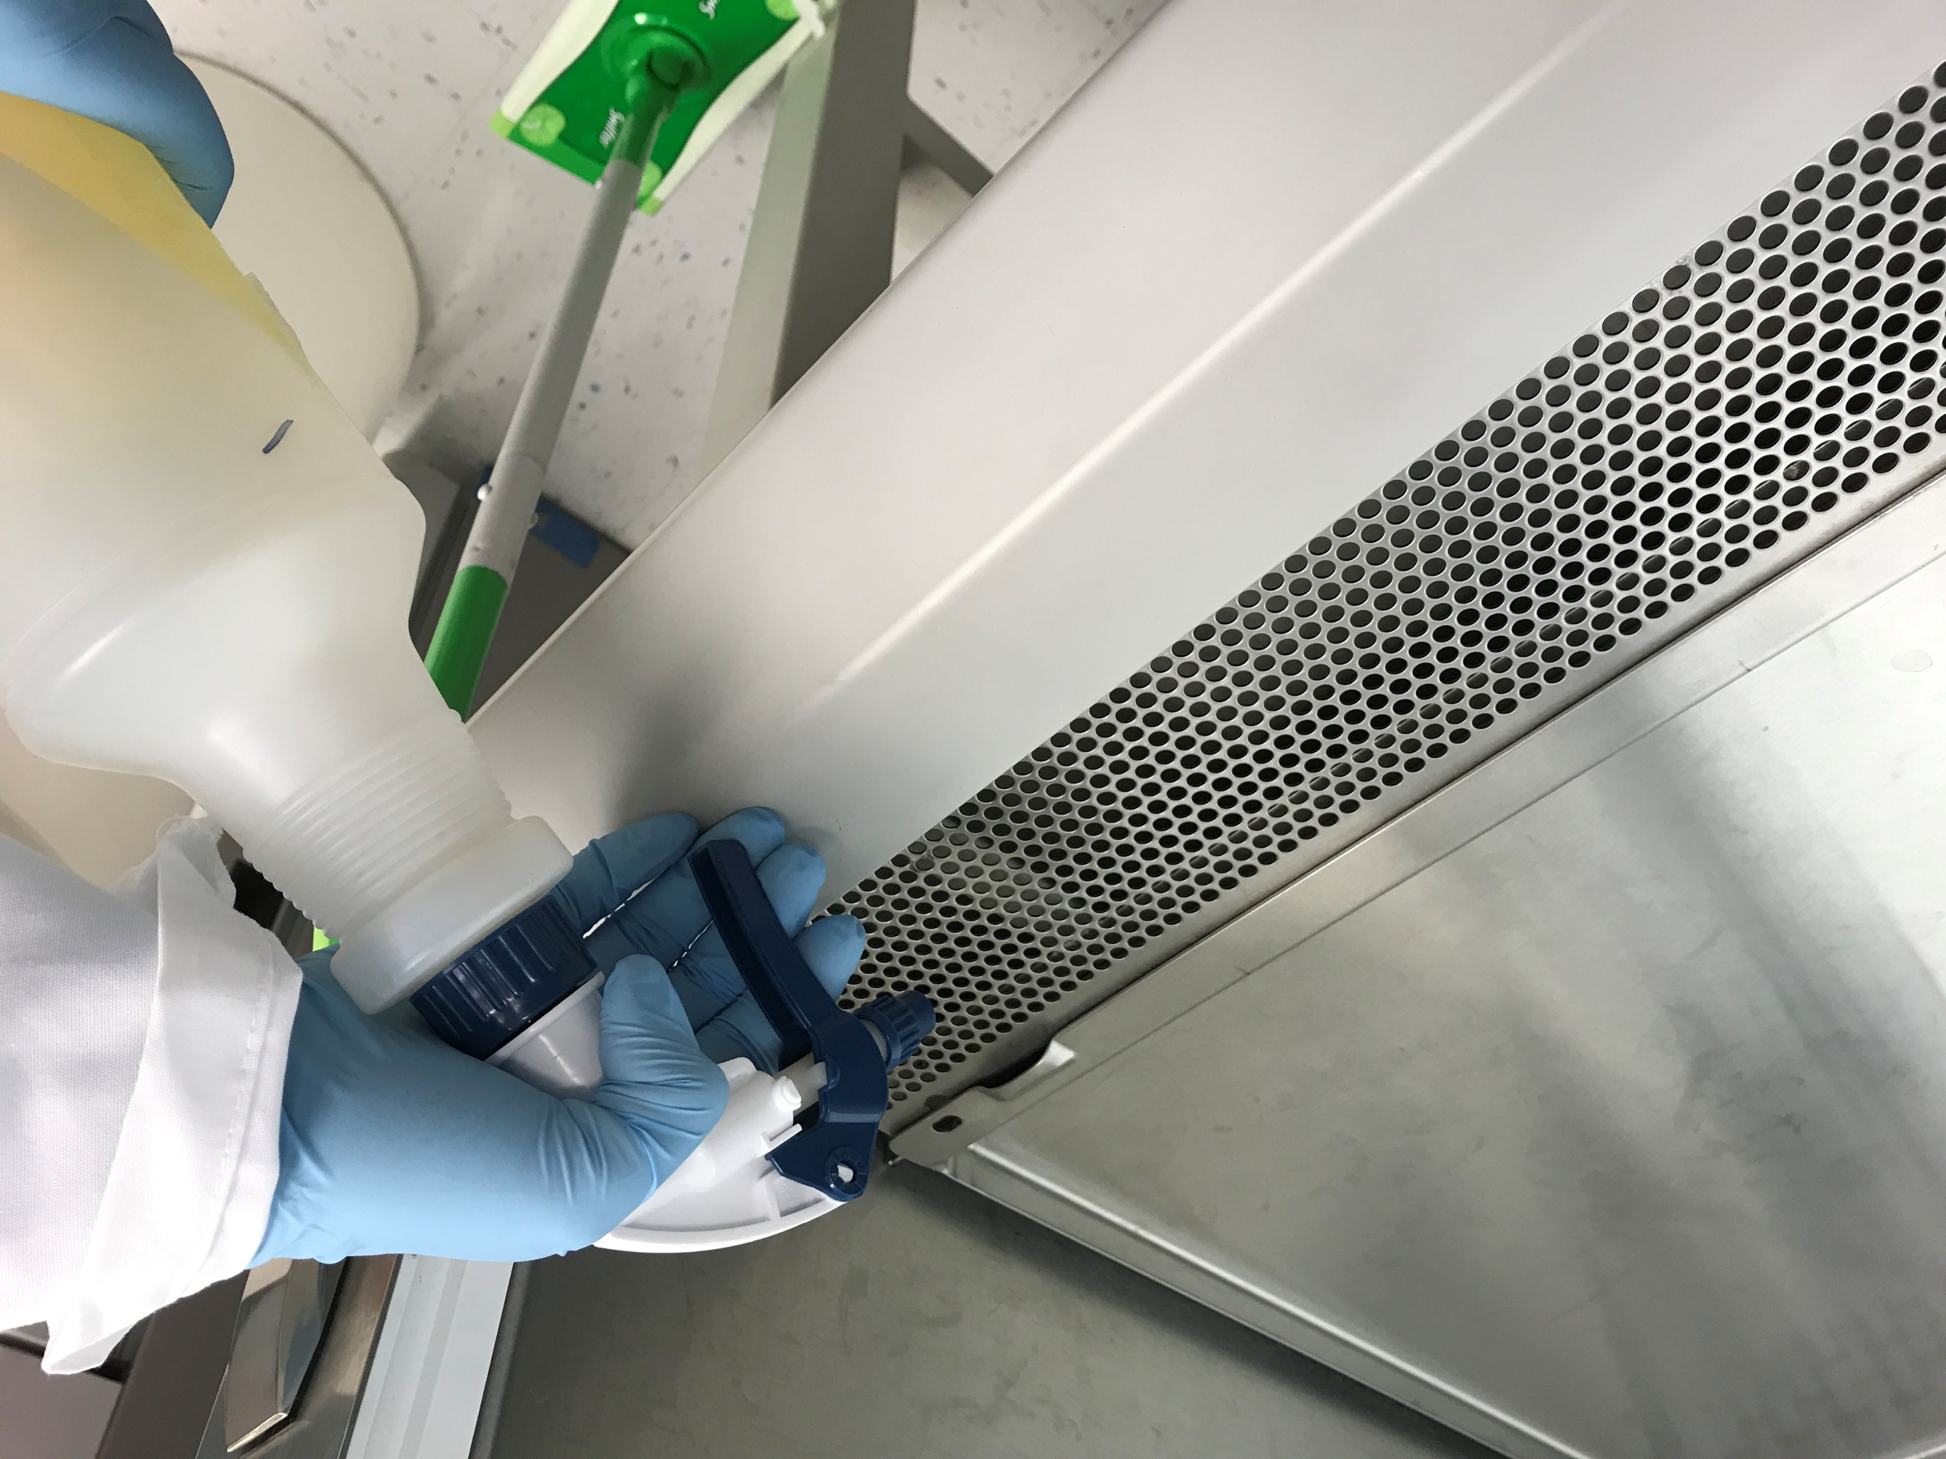
Workspace Deck Removal
Prepare Workspace Deck
for Removal
Remove screw pins that are holding the front grill in place.
Spray down the front grill, being sure to saturate the underside.
Ensuring the drain is closed, SLOWLY pour 1L diluted bleach down the grill

Slide 7
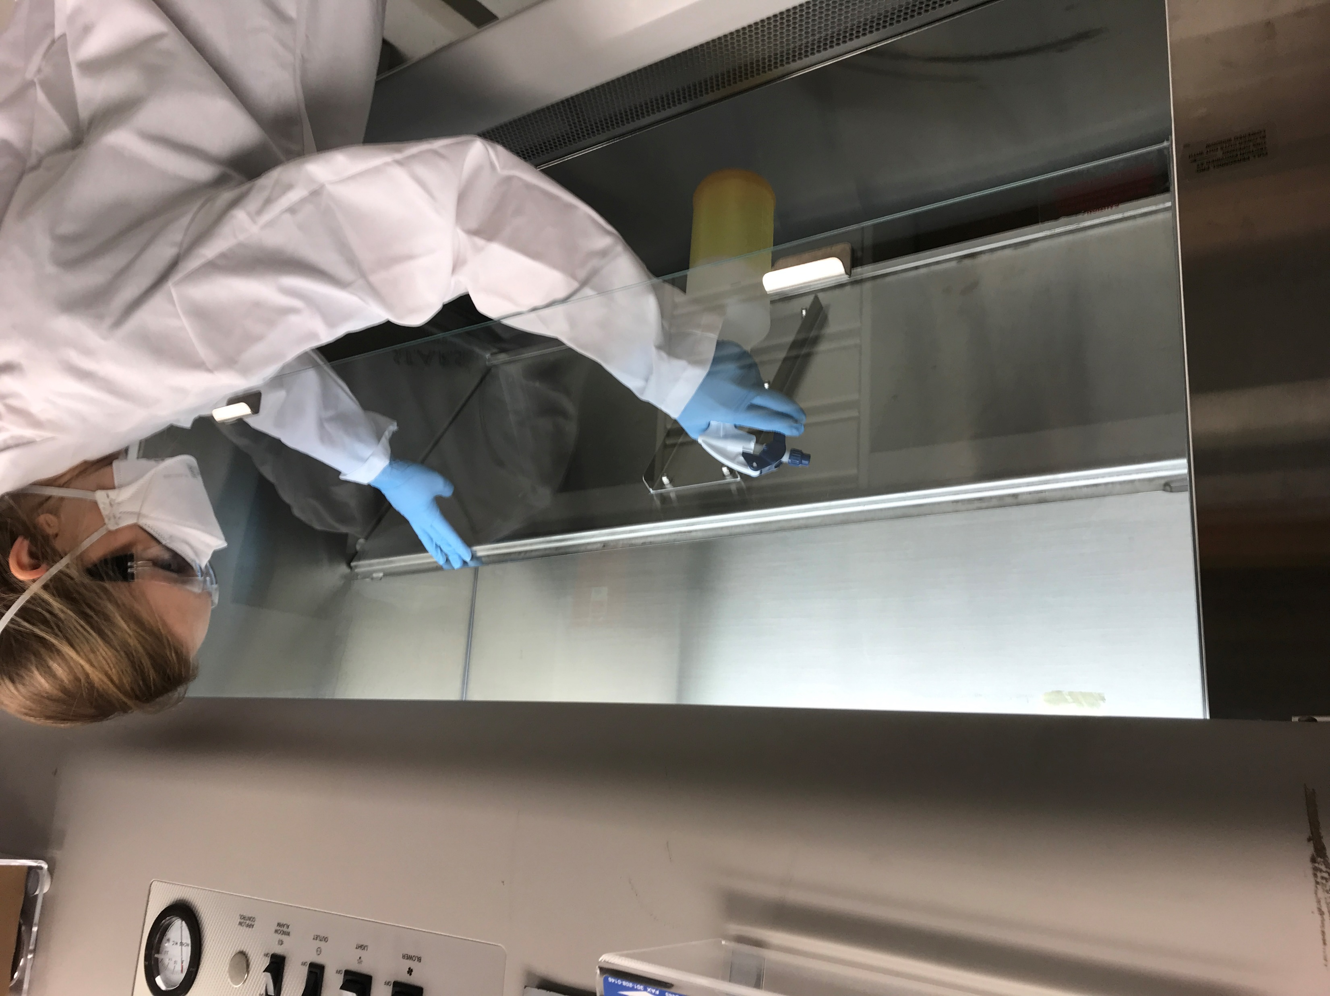
Lower Workspace Deck Cleaning
Open the Lower Deck
Lift the lower workspace deck and spray down with 1:10 bleach solution, making sure to saturate the entire surface
This process may require 2 persons if the BSC is 6 ft or larger
Allow 10 minutes of contact time for the bleach to disinfect all potentially contaminated surfaces
Remove any large debris by hand (i.e., kimwipes, pipette tips, etc.)

Slide 8
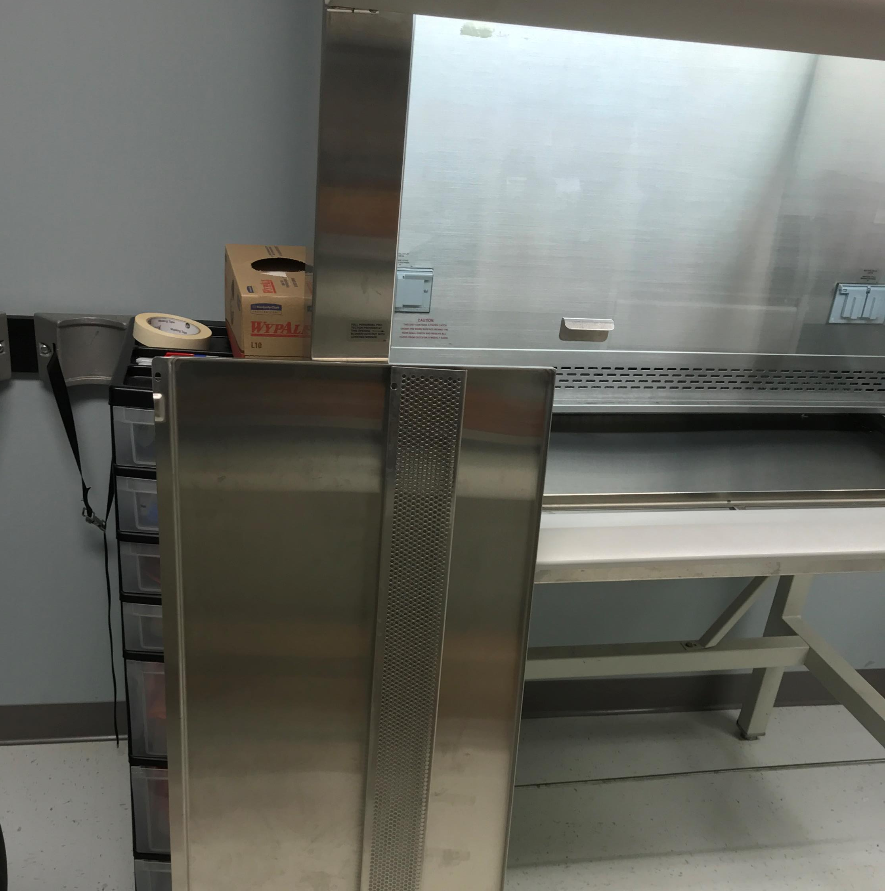
Remove Lower Workspace Deck and Grill
Remove Lower Workspace Deck and Grill
After 10 minutes, remove both front grill and workspace deck.
Be careful and obtain help, these items are both heavy and sharp.
Carefully wipe off all bleach from the front grill and workspace.
Allow several minutes to air dry.
Wipe down the front grill and the bench with 70% EtOH to remove all bleach residue.

Slide 9
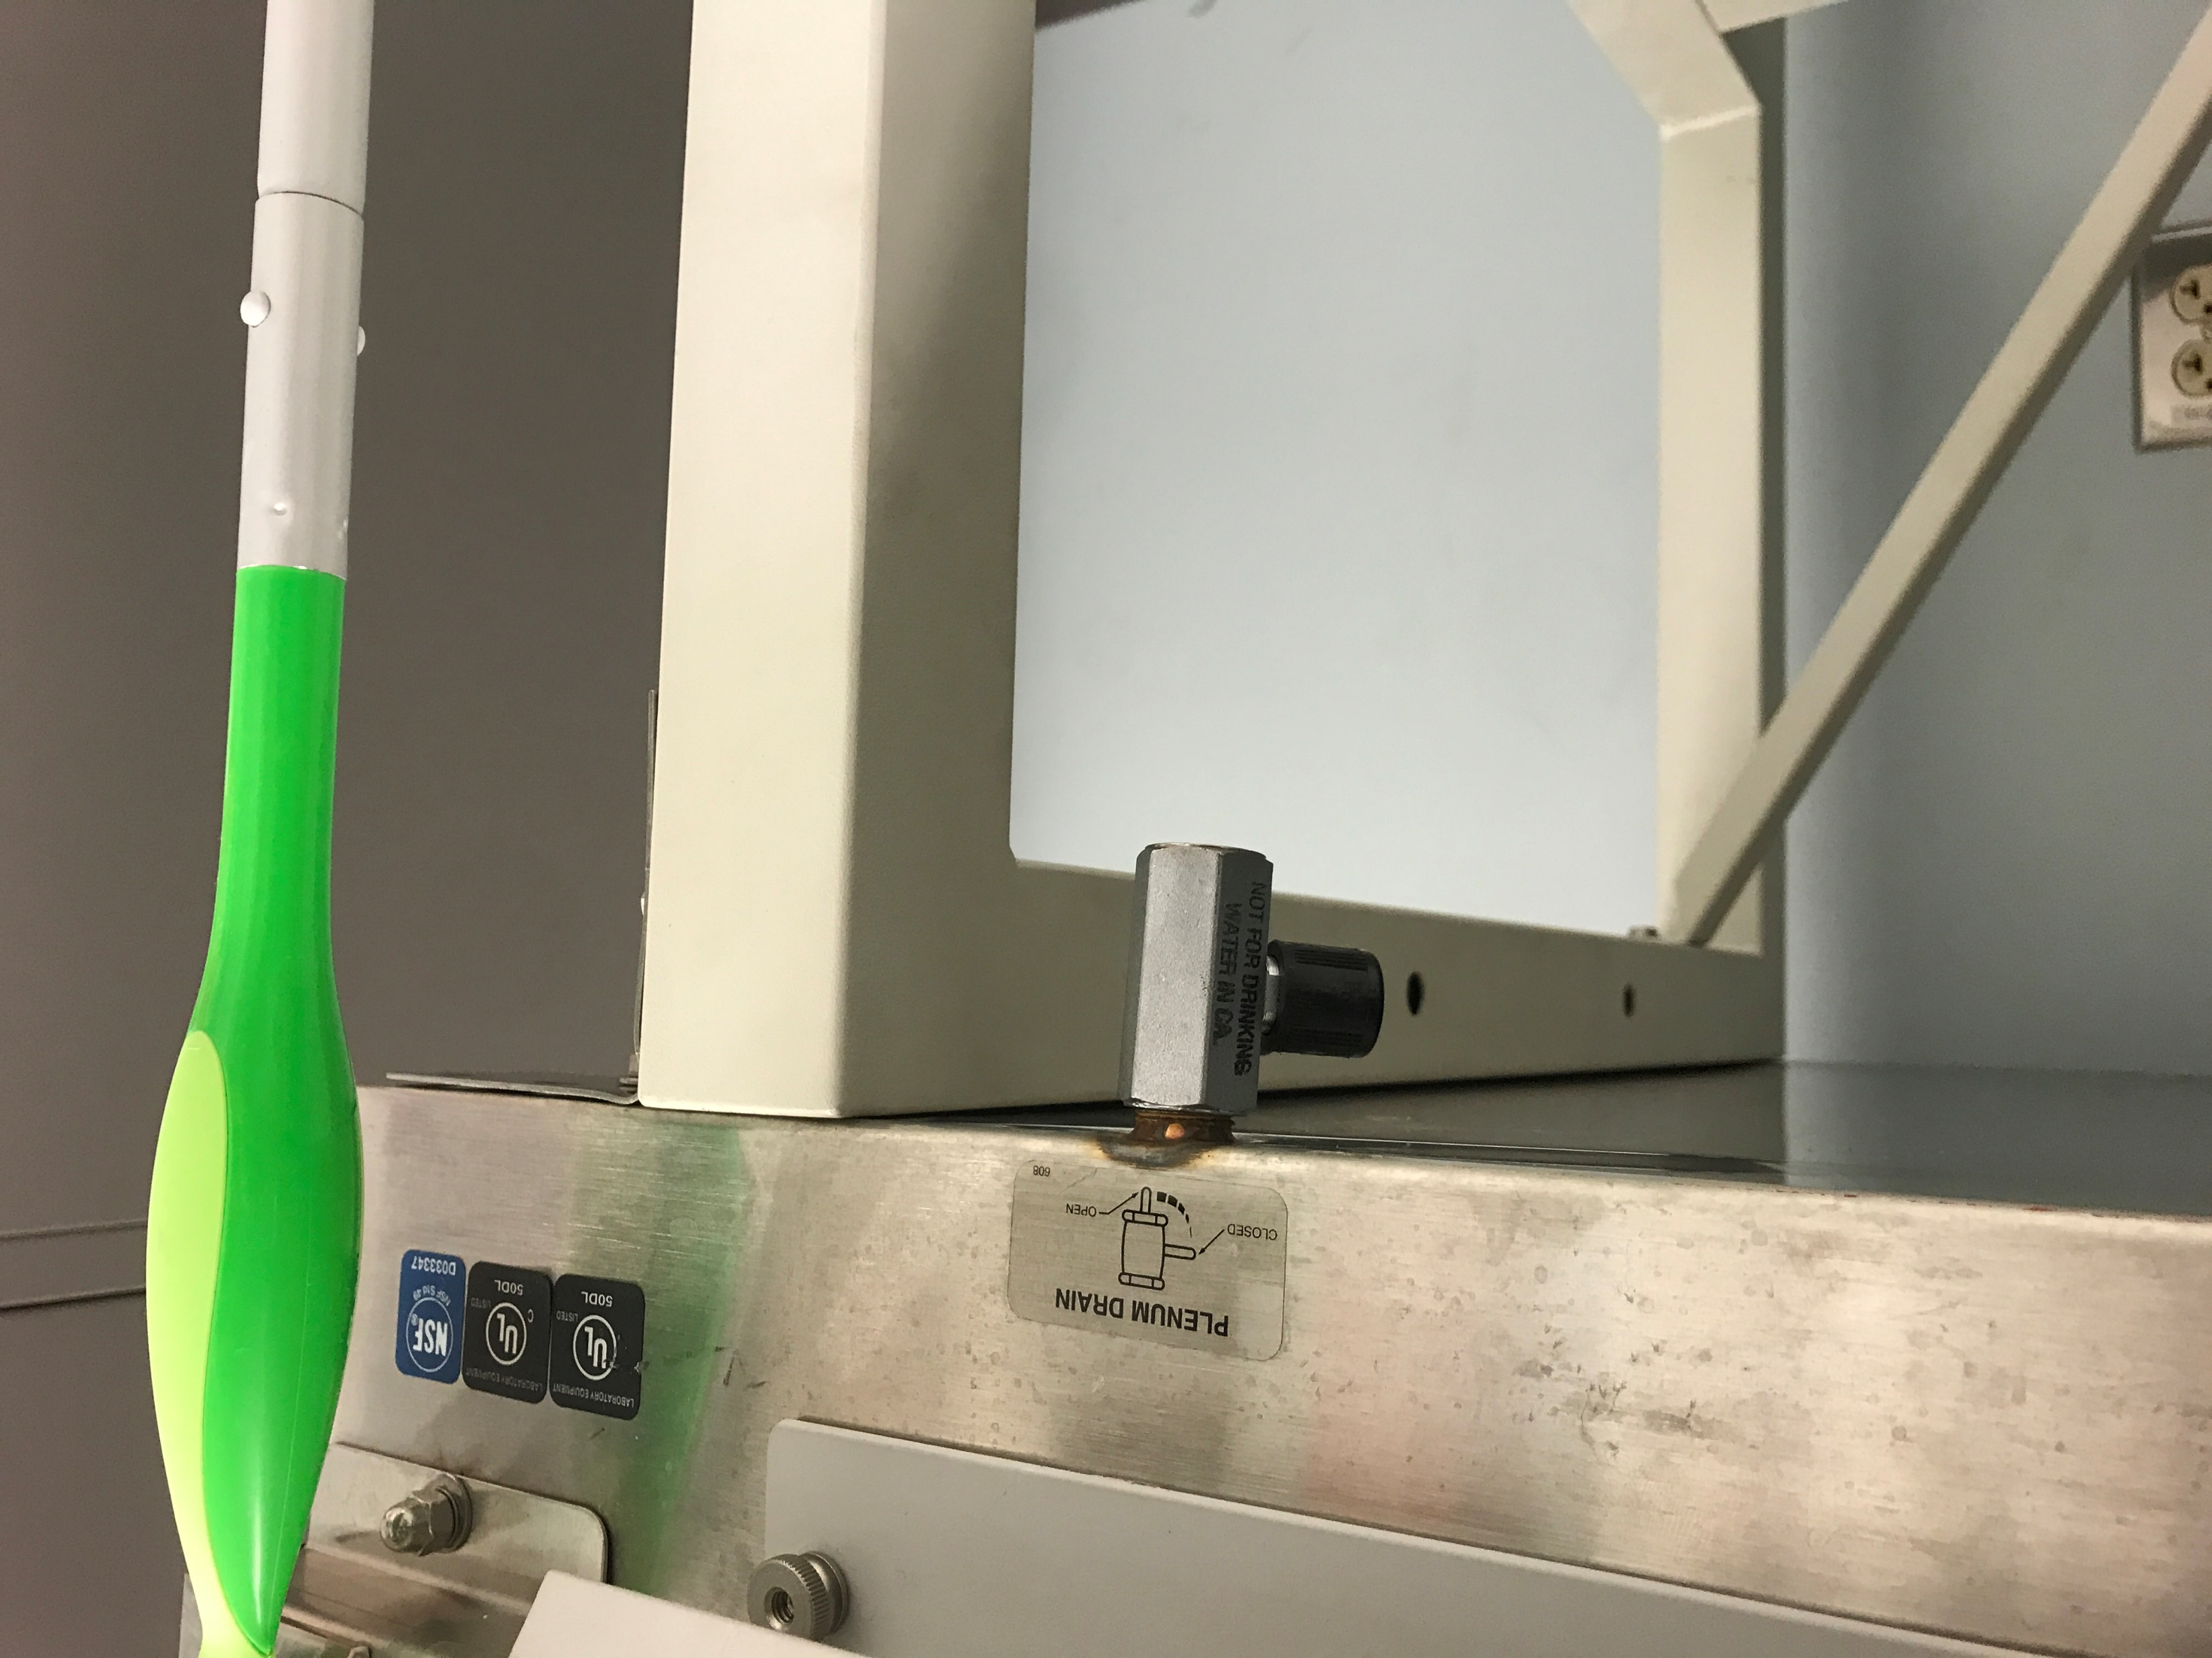
Drain BSC
Drain All Remaining Bleach
Connect tubing to a waste bucket.
Open drain, allowing the bleach to flow into the waste container.
Once fully drained, close the drain.

Slide 10
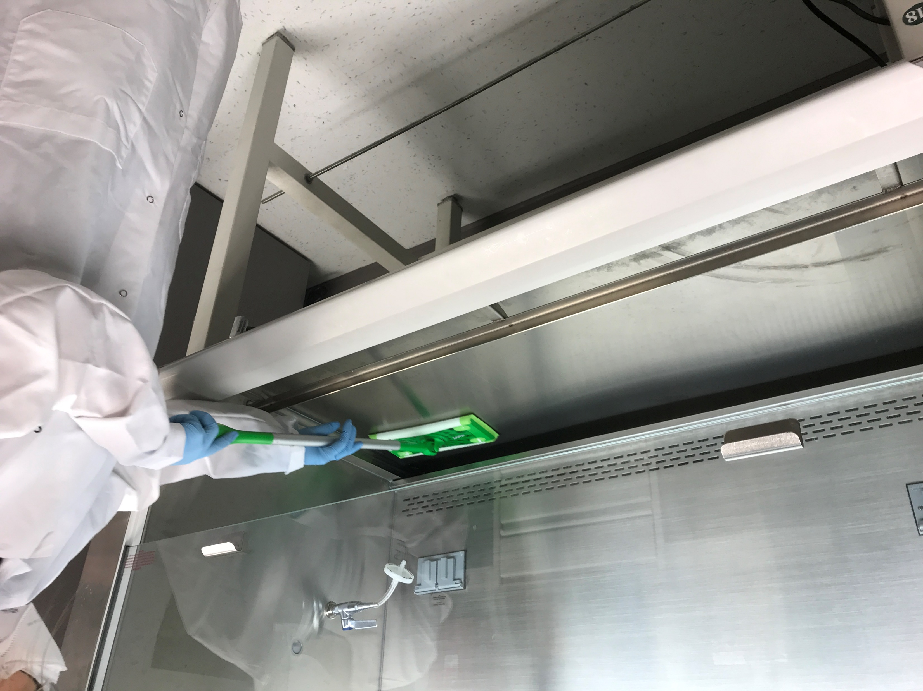
Clean Undersurface of BSC
Clean Undersurface
With the bleach, grill and workspace deck removed, proceed to clean the undersurface removing all dirty, dust, and debris. Clean out the paper-catch.
This will likely require multiple paper towels to remove all material
Allow to air dry
Repeat cleaning the entire undersurface with 70% Ethanol, to prevent corrosion of stainless steel BSC

Slide 11
Reassemble the BSC Unit
Reinstall
Carefully reinstall the lower workspace deck and the front
grill and place screw pins back into place.
Clean surface
Repeat the initial cleaning process with bleach and
70% Ethanol prior to using the BSC.
Doff
Place all soiled PPE and solid cleaning material in an MPW box. Bleach and other cleaning chemicals must be disposed of as Chemical Waste.
Document
Keep a log of when the cleaning was completed. Enhanced BSC cleaning is recommended at least quarterly, but can be more often if required.

Slide 12
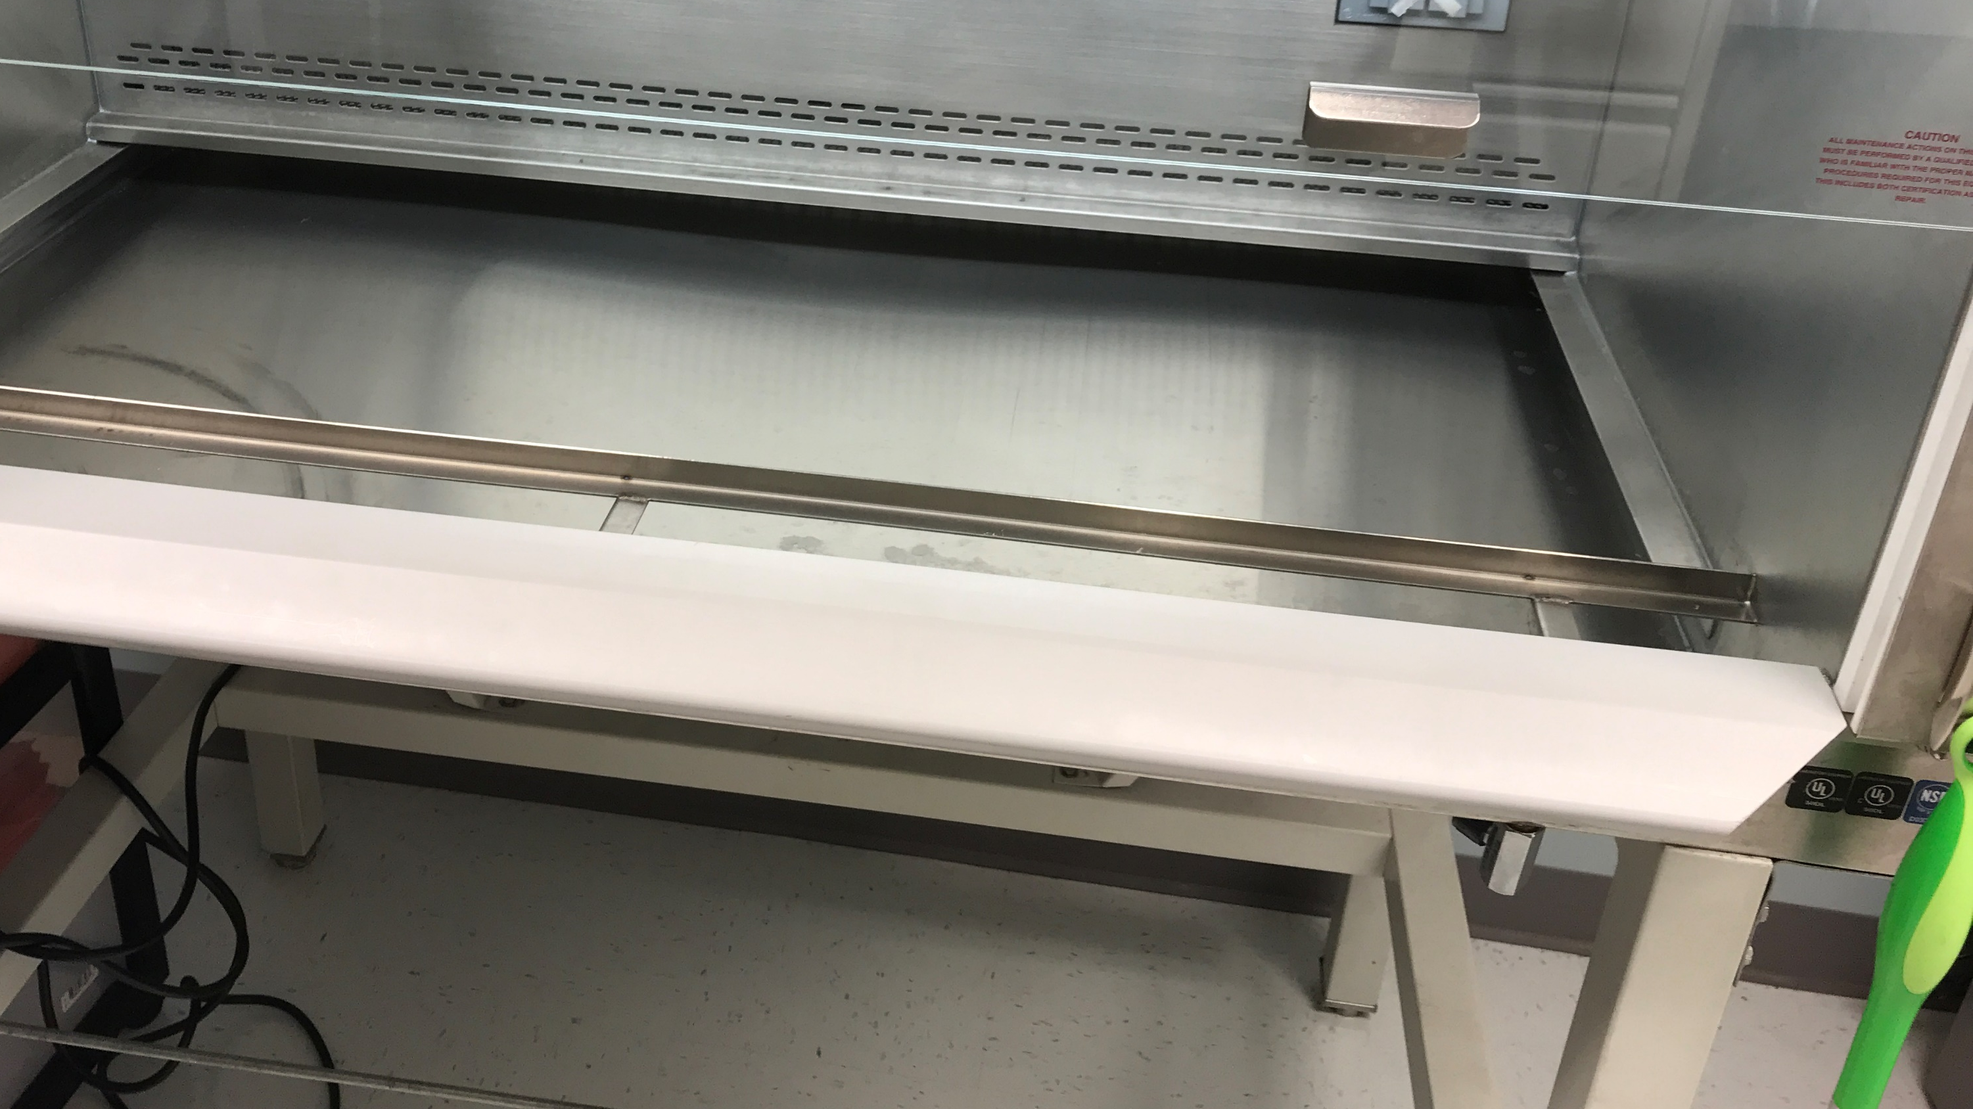
Enhanced BSC Cleaning
Enhanced BSC Cleaning
Allows proper airflow throughout the BSC unit
Lowers the possibility of contamination
Reduces the risk of exposure due to improper airflow
Increases lifespan of the BSC unit

Slide 13
Thank you
Please contact your DOHS Safety Specialist with any procedural questions.
Division of Occupational Health and Safety - NIH Main Campus
Building 13, Room 3K04
13 South Drive, MSC 5760
Bethesda, MD 20852
Tel. (301) 496-2960
Fax. (301) 402-0313

